Slide 1


Research Methods Course
Dr. Moslem Taheri Soodejani
Assistant Professor in Epidemiology
Email address: Moslem.taheri2009@yahoo.com
Healthcare Data Modeling, Departments of Biostatistics and Epidemiology, School of Public Health, Shahid Sadoughi University of Medical Sciences, Yazd, Iran
July, 2025

Slide 2

REFERENCE

Slide 3
Table of contents
Title (research question)
Background
Literature review
Objectives
Study design (Epidemiological approach)
Sampling
Sample size
Data collection
Variables
Statistical analysis

Slide 4

Title (Research question)
A research question in medicine is a precise, clear, and focused inquiry that guides the investigation of a specific health-related issue or phenomenon.
It defines the scope of the study, guiding the selection of methodology, data collection, and analysis.

Slide 5

How to generate a good research question?
A good research question is those address a real gap in knowledge, specific, feasible, and relevant to clinical practice. Following a structured approach helps ensure your question is both meaningful and achievable.

Slide 6
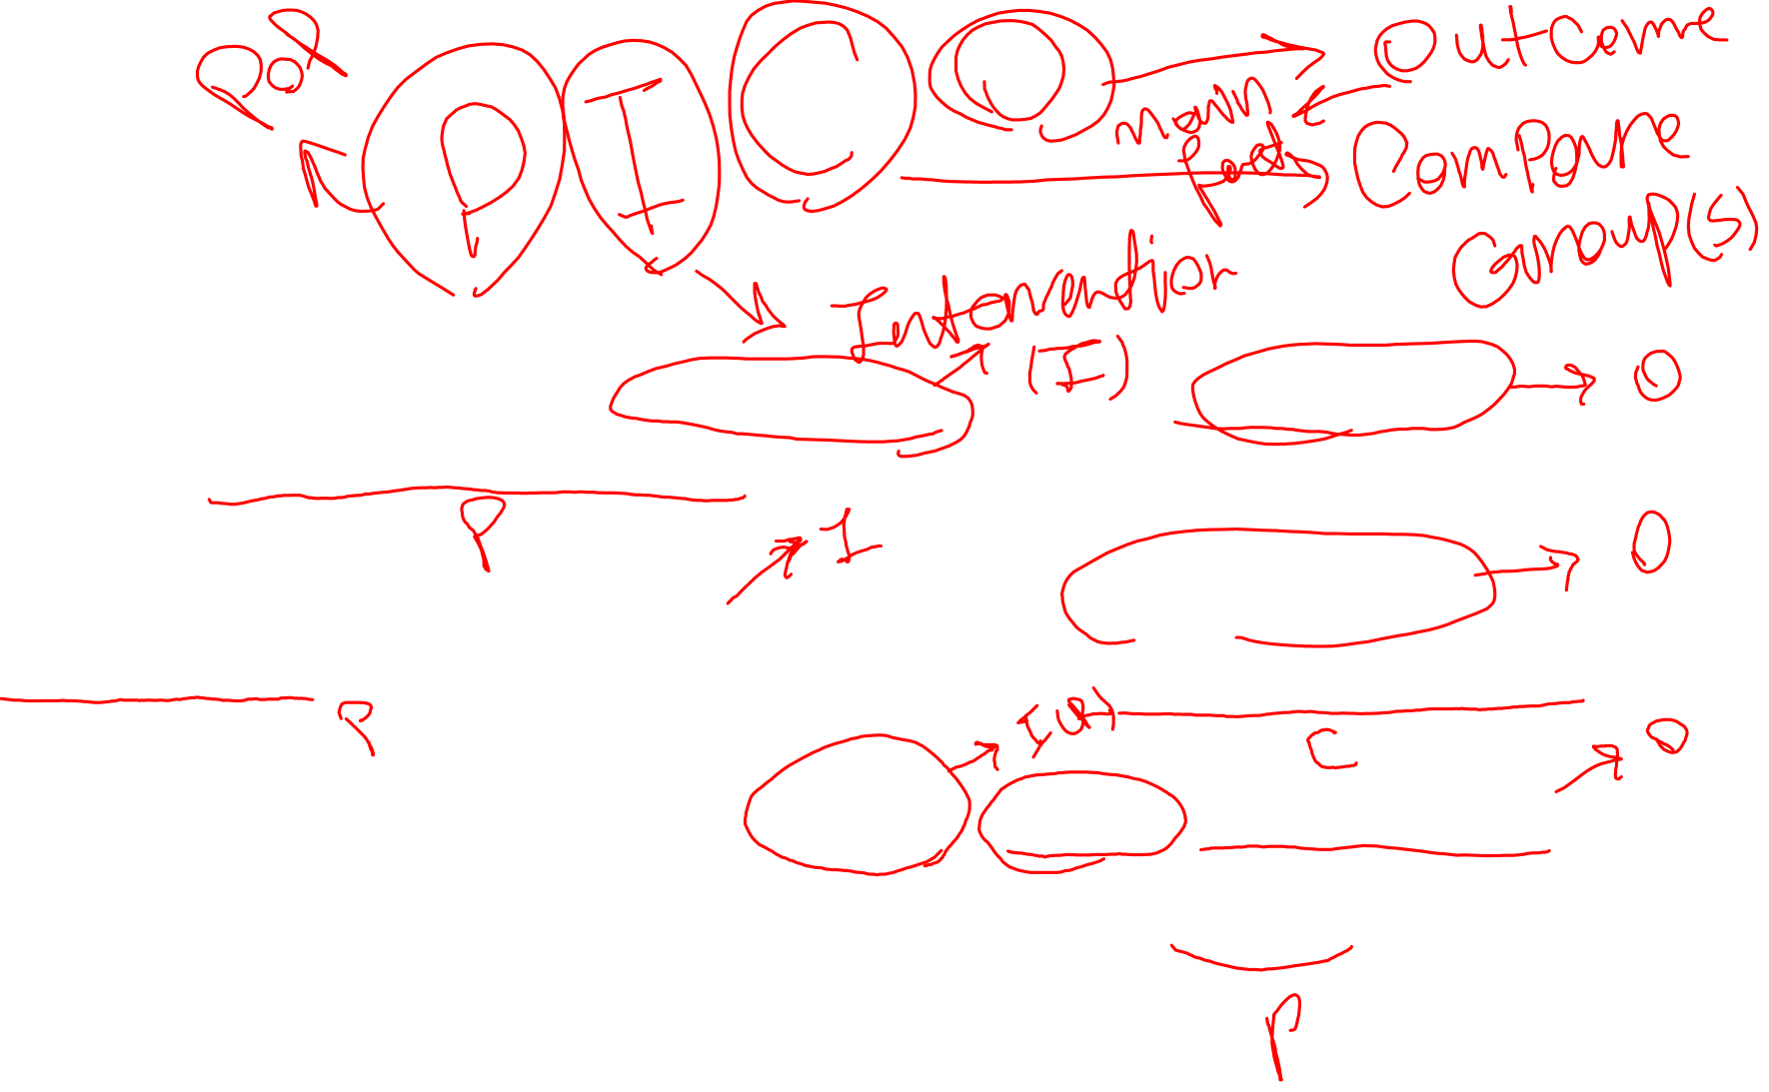
Example
Cardiology:
"What is the effectiveness of beta-blockers in reducing mortality among patients with heart failure with reduced ejection fraction?"
Oncology:
"Does the addition of immunotherapy improve survival rates in patients with advanced melanoma compared to chemotherapy alone?"
Public Health:
"What is the association between smoking cessation and the risk of developing chronic obstructive pulmonary disease (COPD)?"

Slide 7

Example (con.)
Infectious Diseases:
"What is the efficacy of the new antiviral drug in reducing viral load in patients with hepatitis C?"
Neurology:
"Is cognitive-behavioral therapy effective in managing symptoms of depression in patients with multiple sclerosis?"
Endocrinology:
"Does continuous glucose monitoring improve glycemic control in adolescents with type 1 diabetes?"

Slide 8
Example (con.)
Pediatrics:
"Does early nutritional intervention reduce the incidence of developmental delays in preterm infants?"
Orthopedics:
"What are the long-term outcomes of minimally invasive knee replacement surgery compared to traditional techniques?"
Epidemiology:
"What is the prevalence of hypertension among adults aged 40-60 in urban versus rural populations?"
Psychiatry:
"Does early intervention with antidepressants reduce the severity of depression symptoms in adolescents?"

Slide 9

Home work
Generate five research questions in your field.

