Slide 1
Research Methods Course
Dr. Moslem Taheri Soodejani
Assistant Professor in Epidemiology
Email address: Moslem.taheri2009@yahoo.com
Healthcare Data Modeling, Departments of Biostatistics and Epidemiology, School of Public Health, Shahid Sadoughi University of Medical Sciences, Yazd, Iran
July, 2025

Slide 2

Table of contents
Title (research question)
Background
Literature review
Objectives
Study design (Epidemiological approach)
Sampling
Sample size
Data collection
Variables
Statistical analysis

Slide 3

Sampling
Sampling refers to the process of selecting a subset of individuals, groups, or data points from a larger population to participate in a research study. The goal is to obtain a representative sample that accurately reflects the characteristics of the entire population, allowing researchers to generalize their findings.

Slide 4

Sample and population
It is impossible to study every person in a large population. Instead, researchers study a sample to make estimates about the total population.
A population in the context of statistics refers to a complete set of items (such as people, events, households, institutions, or something else) that are the subject of research. The sample is the sub-set of data taken from the population of interest or target population.
A sample is collected from a sampling frame, or the set of information about the accessible units in a sample. Again, these units could be people, events, or other subjects of interest

Slide 5
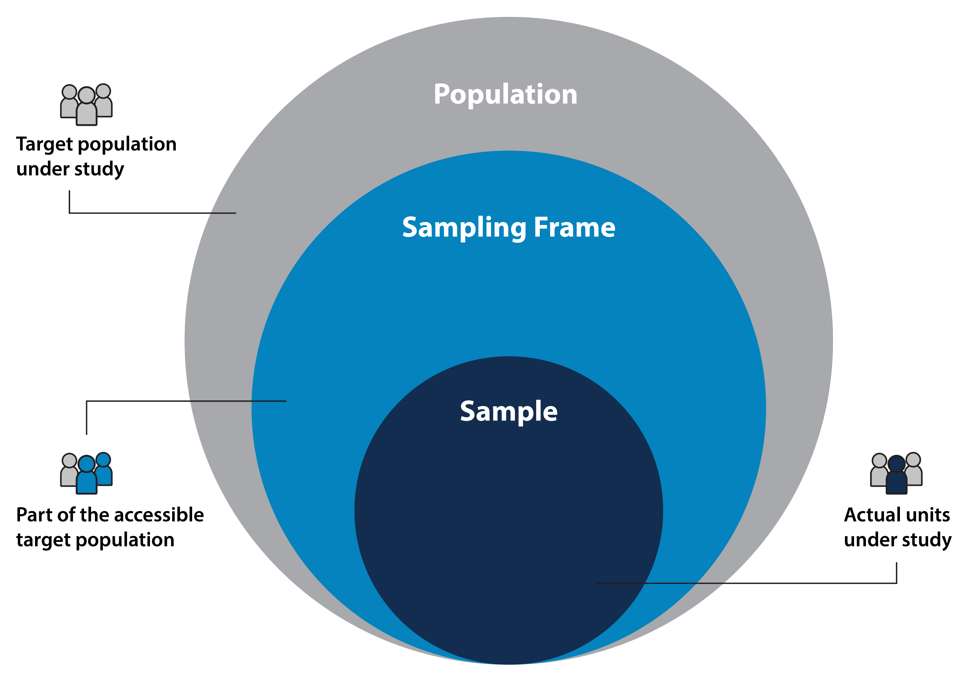
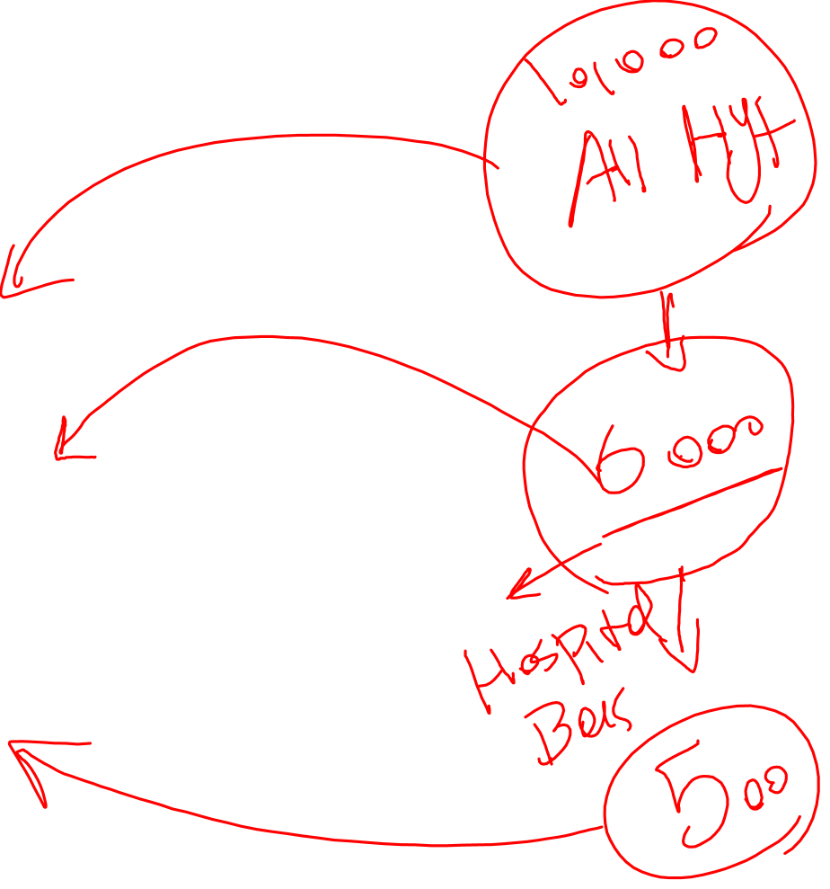
Sample and Population

Slide 6
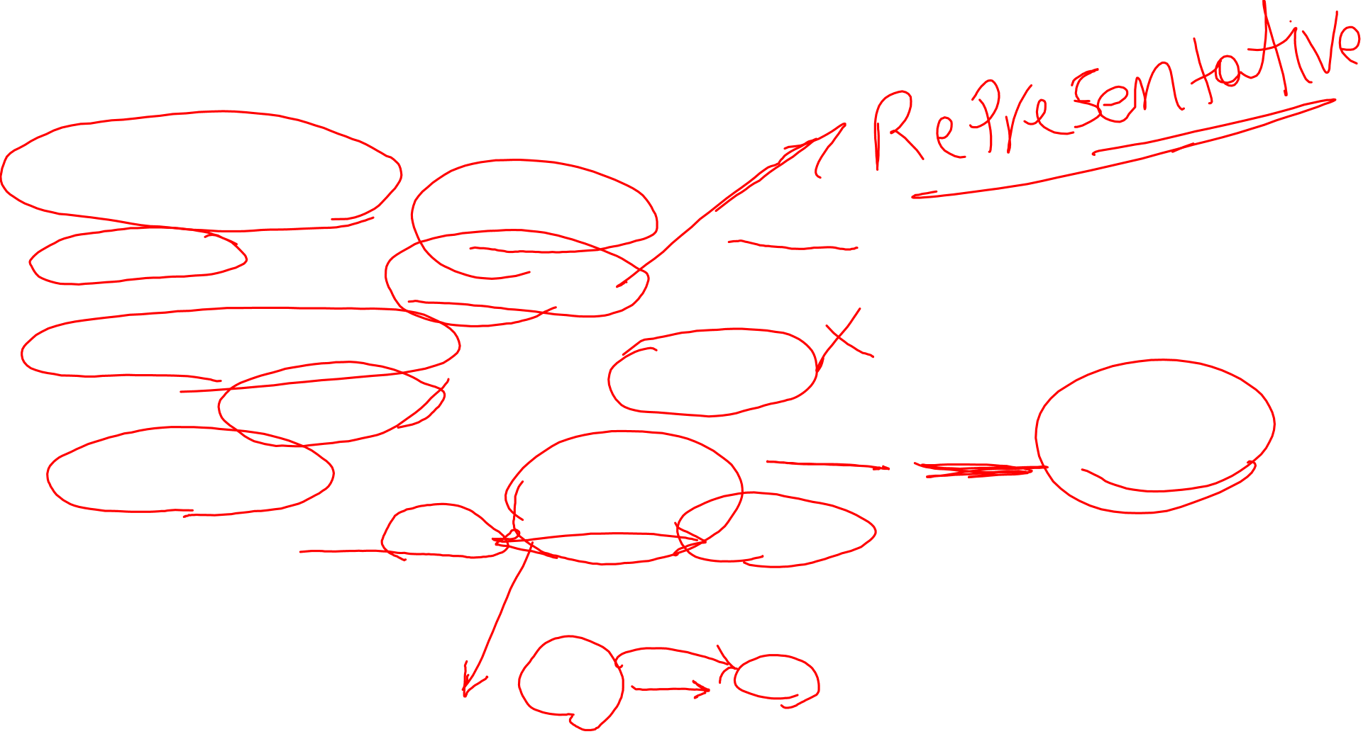
Type of sampling
Probability Sampling
Probability sampling involves random selection, and each person in the group or community has an equal chance of being chosen. In statistical theory based on probability, this means that the sample is more likely to resemble the larger population and thus more accurate inferences can be made about the larger population.
Non-Probability Sampling
Non-probability sampling does not involve random selection and so cannot rely on probability to ensure that it is representative of the population of interest. Researchers use non-probability sampling because in many cases, probability sampling is not practical, feasible, cost effective, or ethical.
Sampling Error
Researchers also should be aware of sampling error. Sampling error is the approximate difference between the results from a sample of people from a larger group, and the likely results of studying every single person in that group. In general, the larger the sample size, the smaller the sampling error. Because it is impossible to know the sampling error exactly, all sampling errors are approximate and are based on what variability is seen using calculations like standard deviation or standard error.

Slide 7
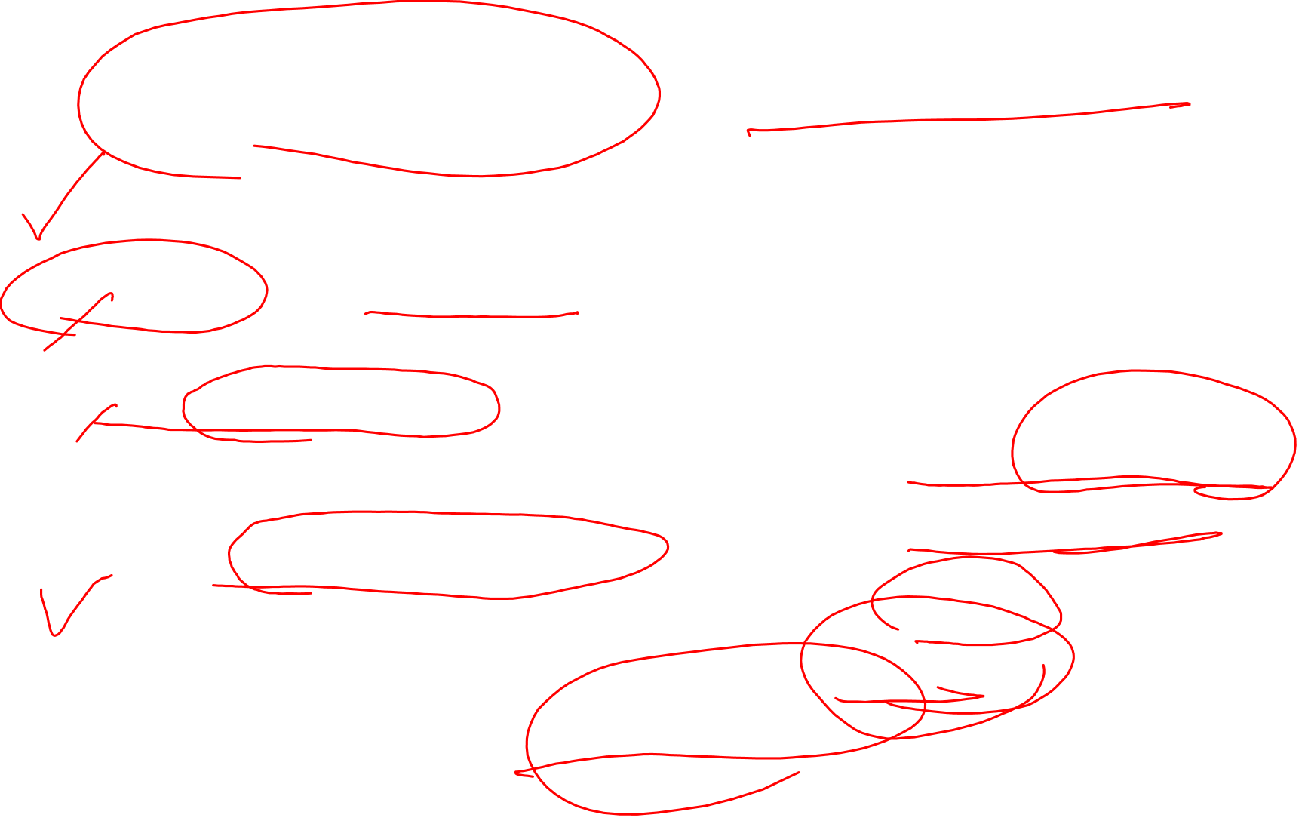
A. Probability Sampling (Random Sampling)
Simple Random Sampling: Every individual in the population has an equal chance of being selected.
Systematic Sampling: Selecting every kth individual from a list after a random starting point.
Stratified Sampling: Dividing the population into strata (subgroups) based on characteristics (e.g., age, gender) and randomly sampling from each stratum proportionally.
Cluster Sampling: Dividing the population into clusters (e.g., hospitals, communities), randomly selecting some clusters, and including all individuals within those clusters.

Slide 8

B. Non-Probability Sampling:
Convenience Sampling: Selecting individuals who are readily available or accessible.
Judgment (Purposive) Sampling: Selecting participants based on the researcher’s judgment about who would be most appropriate.
Quota Sampling: Ensuring the sample reflects certain characteristics of the population but not random selection.
Snowball Sampling: Existing participants recruit future subjects, often used for hard-to-reach populations.

Slide 9
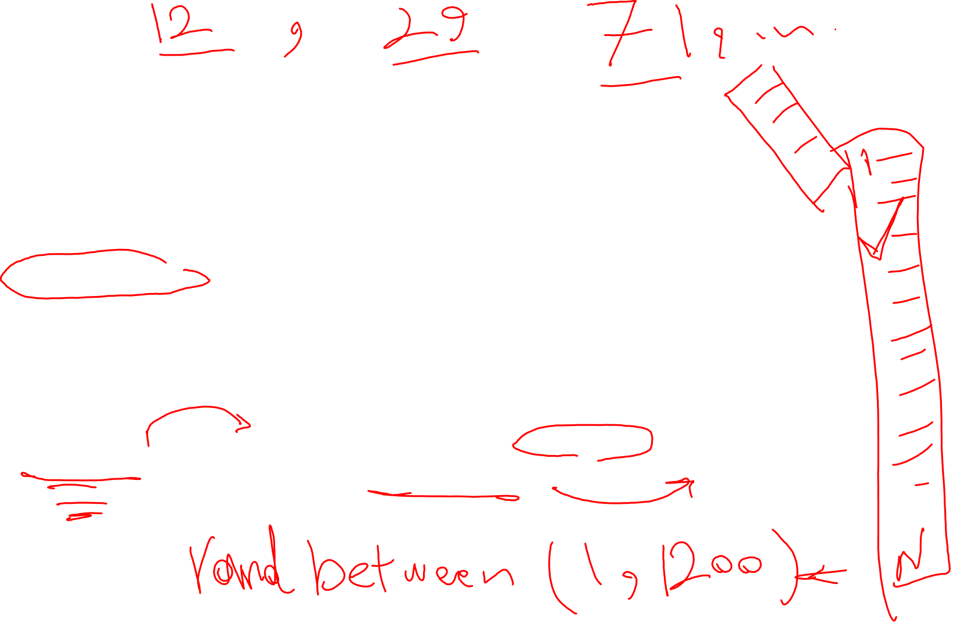
Example (Simple Random Sampling)
Scenario:
A researcher wants to study the blood pressure levels of 200 adult patients in a city hospital.
How simple random sampling is applied:
The researcher obtains a complete list of all adult patients admitted to the hospital during a certain period (the sampling frame).
Each patient on the list is assigned a unique number from 1 to N (total number of patients).
Using a random number generator or lottery method, the researcher randomly selects 200 numbers from this list.
The patients corresponding to these randomly chosen numbers are then included in the study.
Outcome:
This method ensures that every adult patient in the hospital has an equal chance of being selected, minimizing selection bias and making the sample representative of the hospital’s adult patient population.

Slide 10
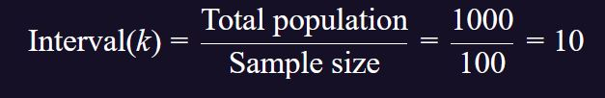

Example (Systematic Random Sampling)
Scenario:
A researcher wants to assess the diet habits of patients visiting a clinic over a month, and there are 1,000 patients expected during this period.
How systematic random sampling is applied:
1. The researcher determines the sample size needed, say 100 patients.
2. They calculate the sampling interval:
3. The researcher randomly selects a starting point between 1 and 10, for example, 4.
4. Starting with patient number 4, they select every 10th patient: 4, 14, 24, 34, ..., up to the 100th patient.
Outcome:
This method ensures a systematic and evenly spread sample throughout the population, reducing potential bias associated with convenience sampling.

Slide 11
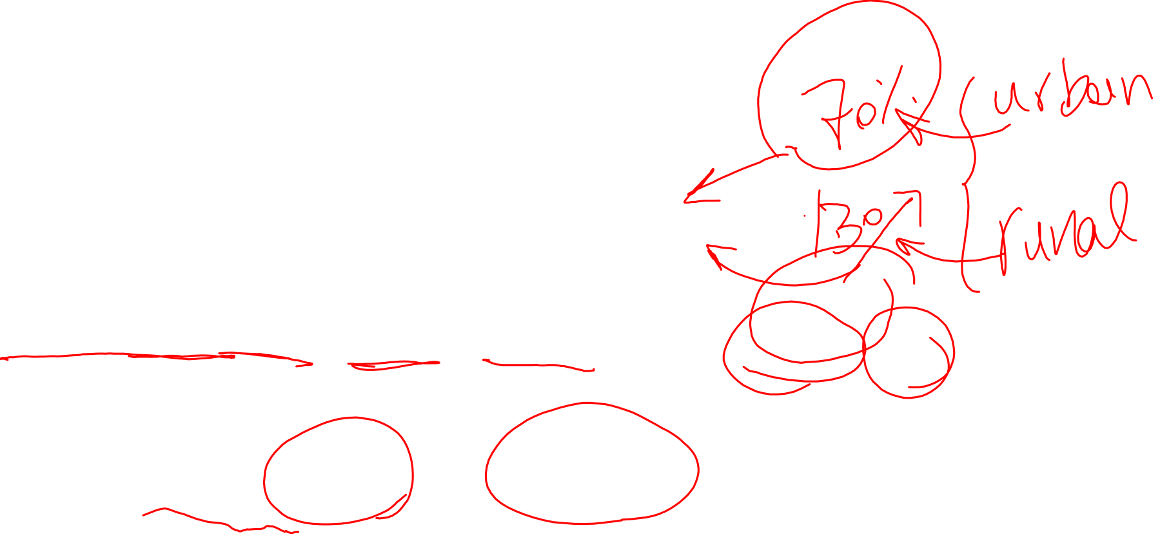
Example (Stratified Sampling )
Scenario:
A researcher wants to study the prevalence of hypertension in a city, and the population consists of different age groups.
How stratified sampling is applied:
The researcher divides the population into strata based on age groups:
  18–30 years
  31–50 years
  51–70 years
  71 years and above
From each age group (stratum), the researcher randomly selects participants proportional to the size of each group in the overall population. For example, if the population is 40% aged 18–30, then 40% of the sample will be from that group.
Within each stratum, participants are chosen randomly, ensuring representation across all age groups.
Outcome:
This method ensures that all age groups are adequately represented, which allows for more precise comparisons between groups regarding hypertension prevalence.

Slide 12
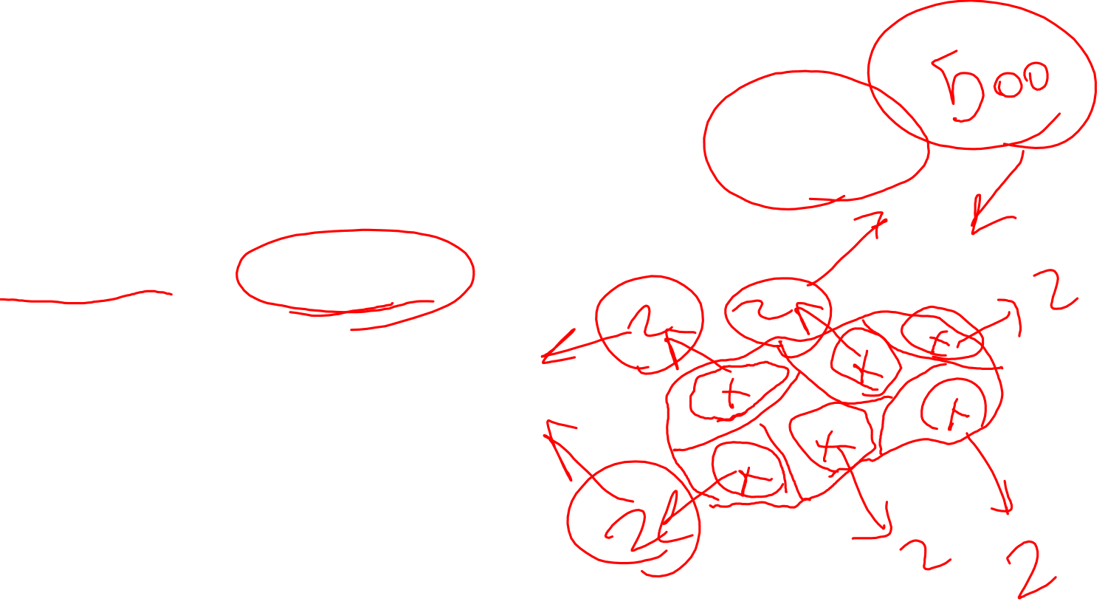
Example (Cluster Sampling)
Scenario:
A researcher wants to study vaccination coverage among children in a large rural area with many villages.
How cluster sampling is applied:
The researcher divides the entire region into clusters, where each cluster is a village.
The researcher randomly selects a number of villages (clusters) from the list of all villages in the region.
All children within the selected villages are included in the study.
Example:
There are 50 villages in the area.
The researcher randomly selects 10 villages.
The study then surveys all children aged 1–5 years in these 10 villages.
Outcome:
This approach is efficient because the researcher only needs to travel to and collect data from a few selected villages, rather than sampling individuals from across the entire region.

Slide 13
Homework
Prepare a sampling frame for your research question.

