Slide 1
Research Methods Course
Dr. Moslem Taheri Soodejani
Assistant Professor in Epidemiology
Email address: Moslem.taheri2009@yahoo.com
Healthcare Data Modeling, Departments of Biostatistics and Epidemiology, School of Public Health, Shahid Sadoughi University of Medical Sciences, Yazd, Iran
July, 2025

Slide 2
Table of contents
Title (research question)
Background
Literature review
Objectives
Study design (Epidemiological approach)
Sampling
Sample size
Data collection
Variables
Statistical analysis

Slide 3
Sample size
sample size refers to the number of participants or observations included in a study. Determining the appropriate sample size is crucial because it affects the study's validity, statistical power, and generalizability of the results.

Slide 4


Why do we need sample size?
Ensure Accurate and Reliable Results:
A proper sample size helps produce results that accurately reflect the true characteristics or effects in the population, reducing the chance of random errors.
Achieve Appropriate Statistical Power:
Adequate sample size increases the likelihood of detecting a real effect or difference (if it exists). This helps prevent Type II errors (failing to detect a true effect).
Avoid Waste of Resources:
Recruiting too many participants can be unnecessary and wasteful of time, money, and effort. Conversely, too few participants can lead to inconclusive or misleading results.
Ensure Ethical Standards:
Using the minimum number of participants necessary to achieve valid results respects the rights and safety of participants, avoiding exposing more people than needed to potential risks.
Support Valid Conclusions:
A well-calculated sample size increases confidence that the study findings are valid, reproducible, and generalizable to the broader population.

Slide 5
Factors Influencing Sample Size:
Study Objectives: Whether estimating a prevalence, comparing groups, or assessing associations.
Expected Effect Size: The magnitude of difference or association expected.
Significance Level (α): Usually set at 0.05, representing the probability of Type I error.
Power (1 - β): Usually set at 80% or 90%, representing the probability of detecting a true effect.
Variability in Data: Greater variability requires a larger sample.
Design of Study: Cross-sectional, cohort, case-control, randomized trial, etc.

Slide 6
Common Methods for Calculating Sample Size:
For estimating a prevalence: Based on expected prevalence and desired precision.
For comparing two groups: Using formulas that incorporate expected differences, standard deviations, significance level, and power.
For correlation studies: Based on expected correlation coefficient.

Slide 7
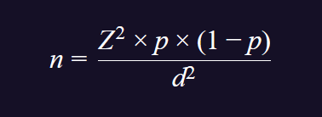
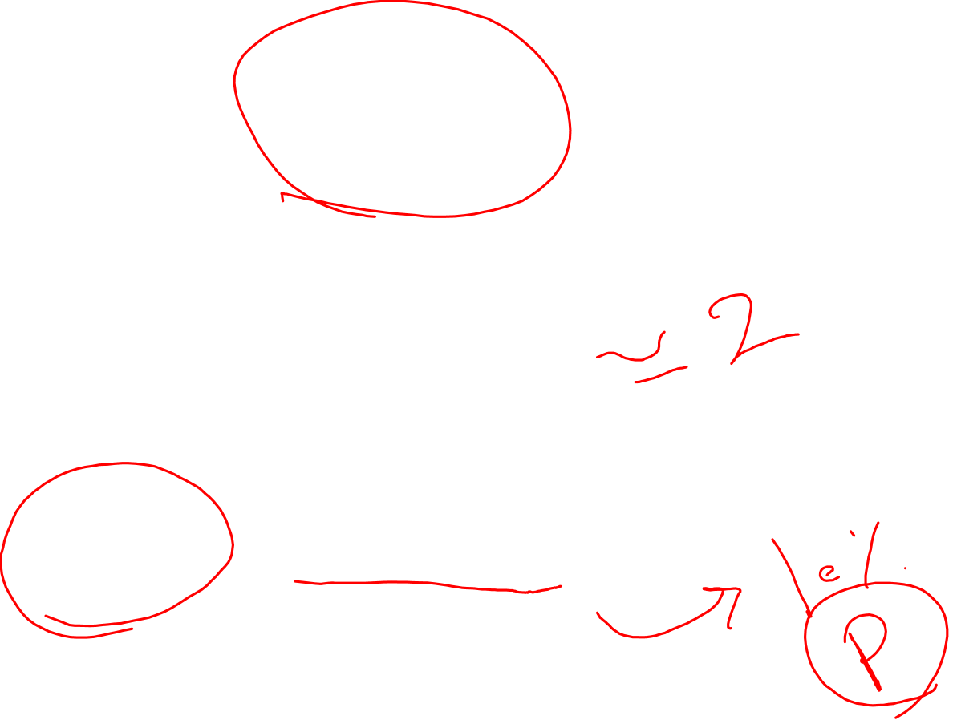
Sample size formula
Sample size for estimating a proportion (prevalence):
n = required sample size
Z = Z-score corresponding to desired confidence level (e.g., 1.96 for 95%)
p = estimated prevalence or proportion in the population (expressed as a decimal)
d = desired margin of error (precision), expressed as a decimal.

Slide 8

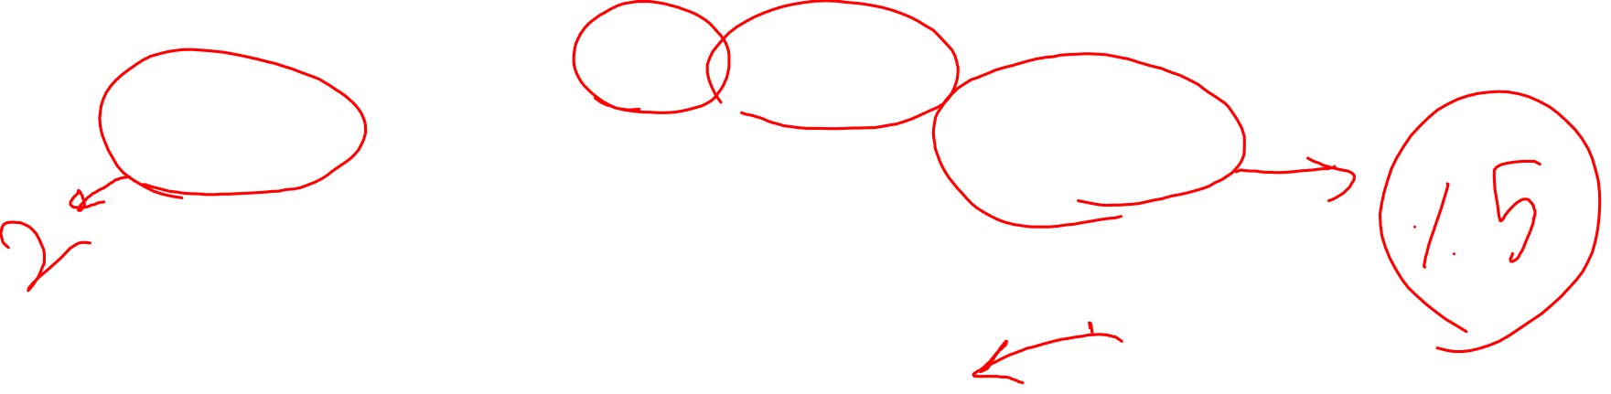
Sample size formula(cont.)
Example of sample size for estimating a proportion (prevalence):
If prevalence is estimated at 10% (p = 0.10), with a 95% confidence level (Z = 1.96), and a margin of error of 5% (d = 0.05):

Slide 9
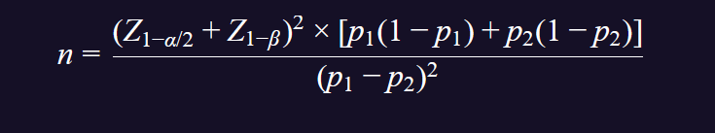

Sample size formula(cont.)
Sample size for comparing two proportions
p₁, p₂ = expected proportions in two groups
Z_{1-\alpha/2} = Z-score for confidence level (e.g., 1.96 for 95%)
Z_{1-\beta} = Z-score for power (commonly 0.84 for 80% power)

Slide 10
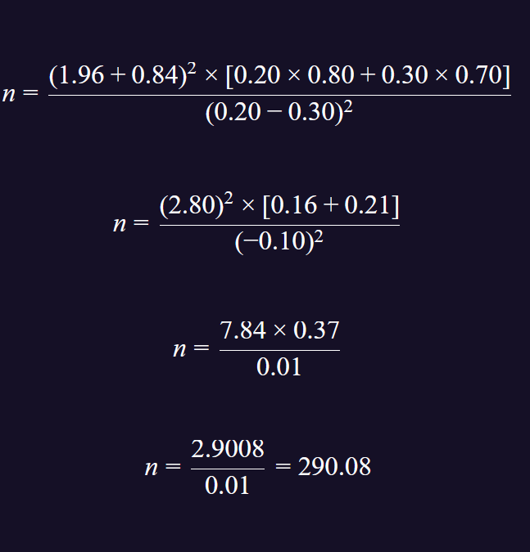
Sample size formula(cont.)
Example of sample size for comparing two proportion
You need approximately 291 participants in each group to detect a difference between the two proportions with 95% confidence and 80% power.

Slide 11
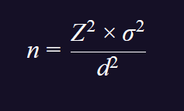
Sample size formula(cont.)
Sample size for estimating a mean
σ = estimated standard deviation
d = desired margin of error (precision)

Slide 12
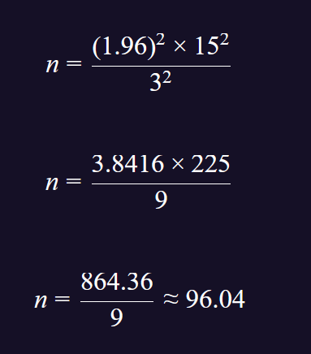
Sample size formula(cont.)
Example of Sample size for estimating a mean
you need approximately 97 participants to estimate the mean blood pressure within a margin of error of 3 mm Hg at a 95% confidence level.

Slide 13
Homework
Calculate sample size for your research question.

