Slide 1
Research Methods Course
Dr. Moslem Taheri Soodejani
Assistant Professor in Epidemiology
Email address: Moslem.taheri2009@yahoo.com
Healthcare Data Modeling, Departments of Biostatistics and Epidemiology, School of Public Health, Shahid Sadoughi University of Medical Sciences, Yazd, Iran
July, 2025

Slide 2

Table of contents
Title (research question)
Background
Literature review
Objectives
Study design (Epidemiological approach)
Sampling
Sample size
Data collection
Variables
Variables
Statistical analysis

Slide 3
Data collection
Data collection in medical research is a crucial step that involves gathering accurate and relevant information to answer research questions, test hypotheses, or evaluate interventions.

Slide 4

Types of Data in Medical Research:
Primary Data: Collected directly from original sources, such as surveys, clinical trials, interviews, or physical examinations.
Secondary Data: Existing data from records, databases, or previous studies.

Slide 5
Methods of Data Collection:
1. Surveys and Questionnaires:
Used to gather information on symptoms, behaviors, or opinions.
Can be administered in person, by phone, mail, or electronically.

Slide 6
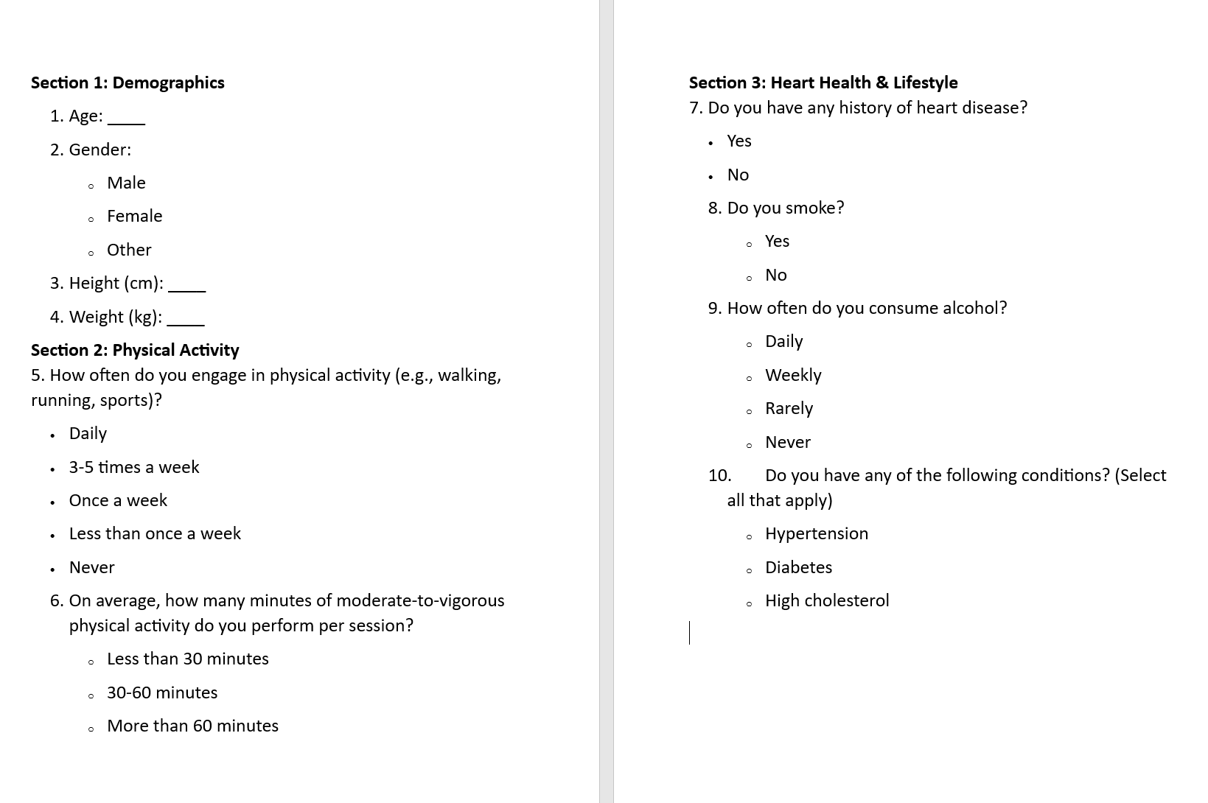
1. Surveys and Questionnaires (example)
Example: Survey on Lifestyle and Heart Health
Objective: To assess the relationship between physical activity levels and cardiovascular health among adults.

Slide 7
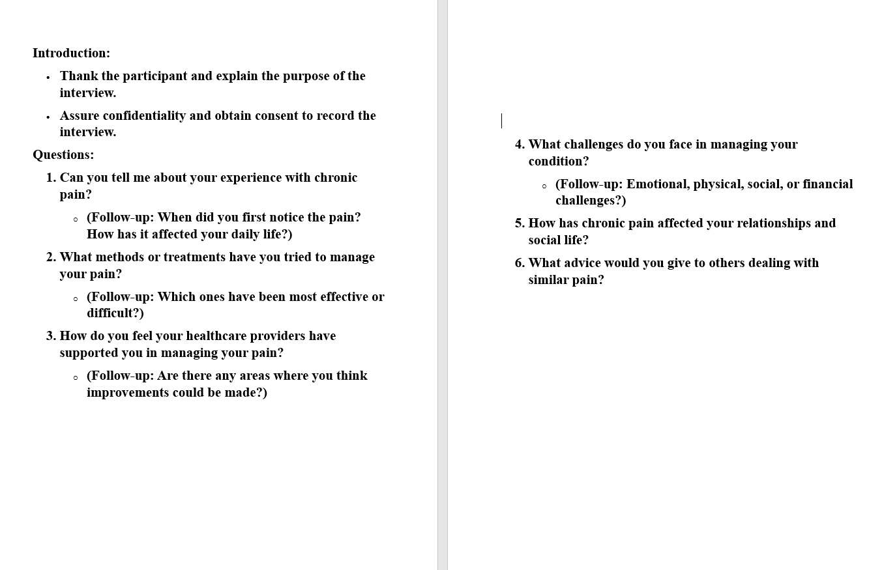
2. Interviews
Structured, semi-structured, or unstructured.
Useful for qualitative data.

Slide 8
3. Clinical Examinations and Physical Measurements:
Collect objective data such as blood pressure, weight, height.
Example: Blood Pressure Measurement in a Hypertension Study
Objective: To assess blood pressure levels among participants to study hypertension prevalence.

Slide 9
4. Laboratory Tests:
Blood tests, imaging, biopsies, etc
Example: Fasting Blood Glucose Test
Objective: To assess the blood sugar level of participants to study the prevalence of diabetes.

Slide 10
5. Medical Records Review:
Extract relevant data from patient charts, electronic health records.
Example: Reviewing Medical Records to Study Postoperative Complications
Objective: To assess the rate and types of complications following abdominal surgery.

Slide 11
6. Observation:
Monitoring behaviors or environmental factors.
Example: Observational Study of Hand Hygiene Practices in a Hospital
Objective: To observe and assess the hand hygiene compliance among healthcare workers in a hospital ward.

Slide 12
7. Technological Devices:
Wearables, sensors, or mobile apps for real-time data
Example: Using a Wearable Activity Tracker to Measure Physical Activity
Objective: To objectively measure the physical activity levels of participants with chronic obstructive pulmonary disease (COPD).

Slide 13
Steps in Data Collection:
Define Objectives and Variables:
Clearly specify what data are needed.
Design Data Collection Tools:
Develop questionnaires, forms, or protocols.
Sampling:
Decide on sampling methods (random, stratified, convenience).
Pilot Testing:
Test tools on a small sample to ensure clarity and effectiveness.
Data Collection:
Train personnel.
Collect data systematically, ensuring consistency.
Data Management:
Organize, store, and maintain data securely.
Use databases or software for data entry and validation

Slide 14
Homework
Determine the type of data collection for your research question.

