Slide 1
Research Methods Course
Dr. Moslem Taheri Soodejani
Assistant Professor in Epidemiology
Email address: Moslem.taheri2009@yahoo.com
Healthcare Data Modeling, Departments of Biostatistics and Epidemiology, School of Public Health, Shahid Sadoughi University of Medical Sciences, Yazd, Iran
July, 2025

Slide 2

Table of contents
Title (research question)
Background
Literature review
Objectives
Study design (Epidemiological approach)
Sampling
Sample size
Data collection
Variables
Statistical analysis

Slide 3

Variables
Variables in medical research are characteristics or factors that can take on different values and are studied to understand their relationship with health outcomes.

Slide 4

Type of variable according to scale
Nominal Variables (Categorical)
Definition: Variables that represent categories without any intrinsic order.
Examples:
  Gender (Male, Female)
  Blood type (A, B, AB, O)
  Presence or absence of a disease (Yes/No)

Slide 5
Type of variable according to scale(cont.)
Ordinal Variables
Definition: Variables with categories that have a logical order but the intervals between categories are not necessarily equal.
Examples:
  Pain severity (None, Mild, Moderate, Severe)
  Stage of cancer (Stage I, Stage II, Stage III, Stage IV)
  Socioeconomic status (Low, Middle, High)

Slide 6

Type of variable according to scale( cont.)
Interval Variables
Definition: Numeric variables where the difference between values is meaningful, but there is no true zero point.
Examples:
  Temperature in Celsius or Fahrenheit
  Calendar years

Slide 7

Type of variable according to scale( cont.)
Ratio Variables
Definition: Numeric variables with a true zero point, allowing for meaningful ratio comparisons.
Examples:
  Blood pressure (mm Hg)
  Weight (kg)
  Height (cm)
  Number of hospital visits

Slide 8
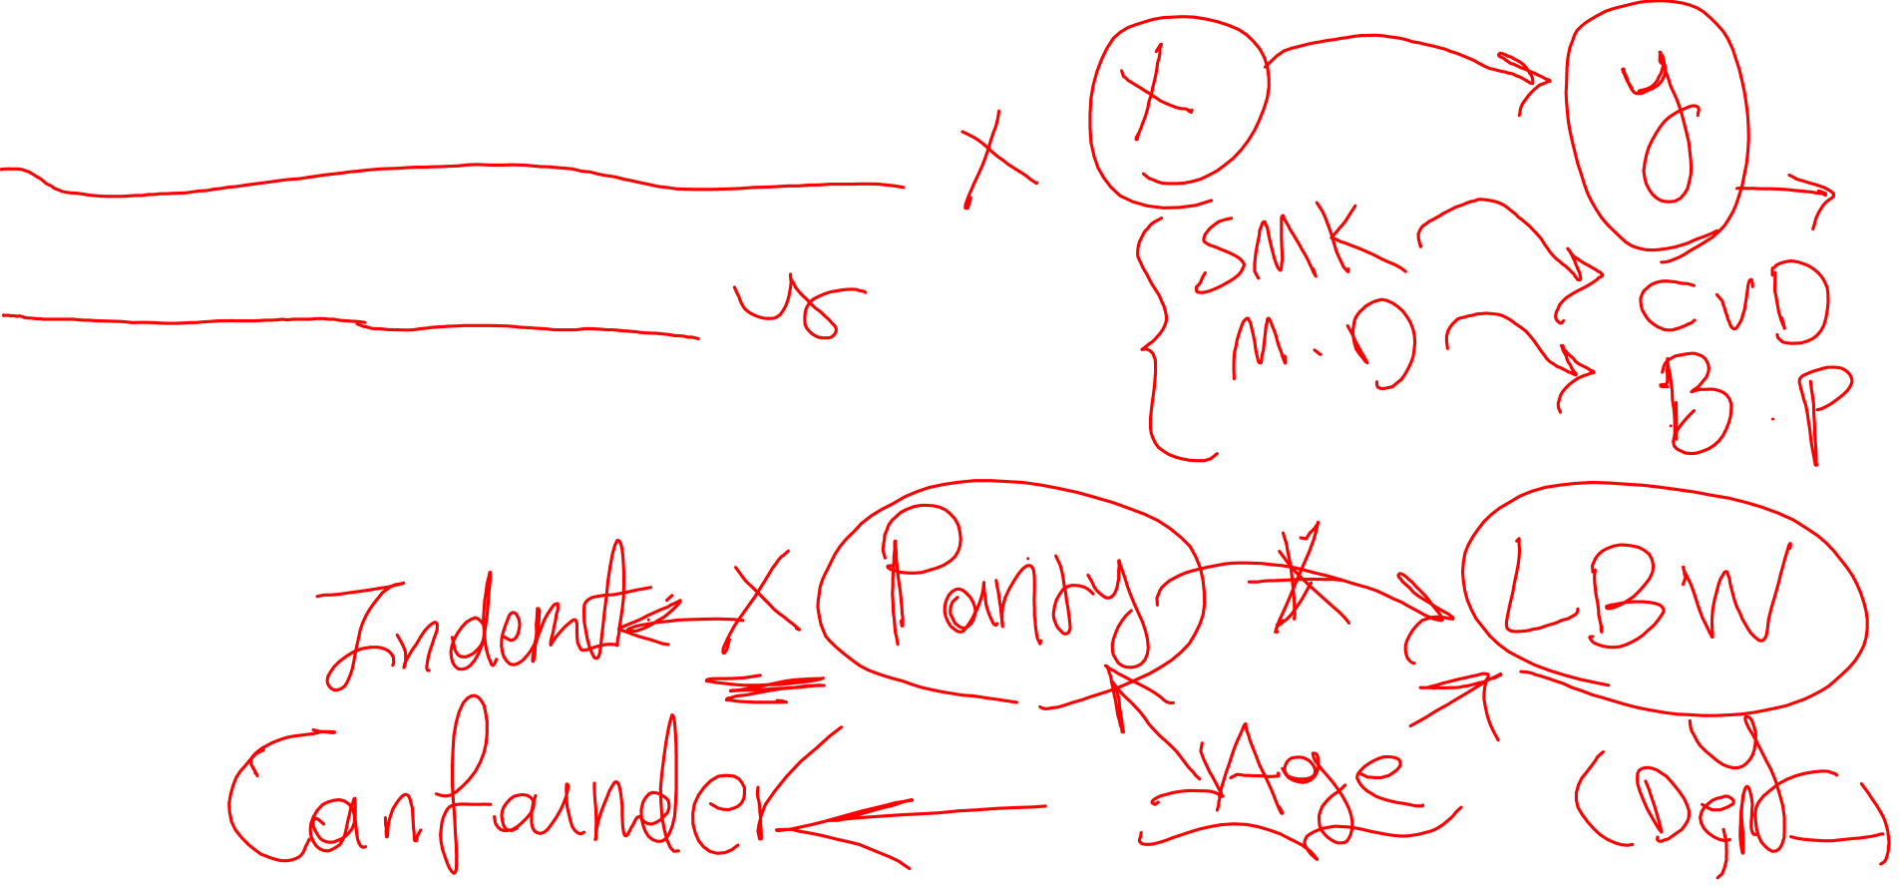
Type of variables according to role in research
Independent Variables (Predictor or Exposure Variables):
Factors believed to influence or predict the outcome.
Example: Smoking status, medication dose, physical activity level.
Dependent Variables (Outcome Variables):
The main result or condition being measured or affected.
Example: Blood pressure, presence of disease, survival rate.
Confounding Variables:
Factors that may influence both the independent and dependent variables, potentially distorting the true relationship.
Example: Age, socioeconomic status.

Slide 9
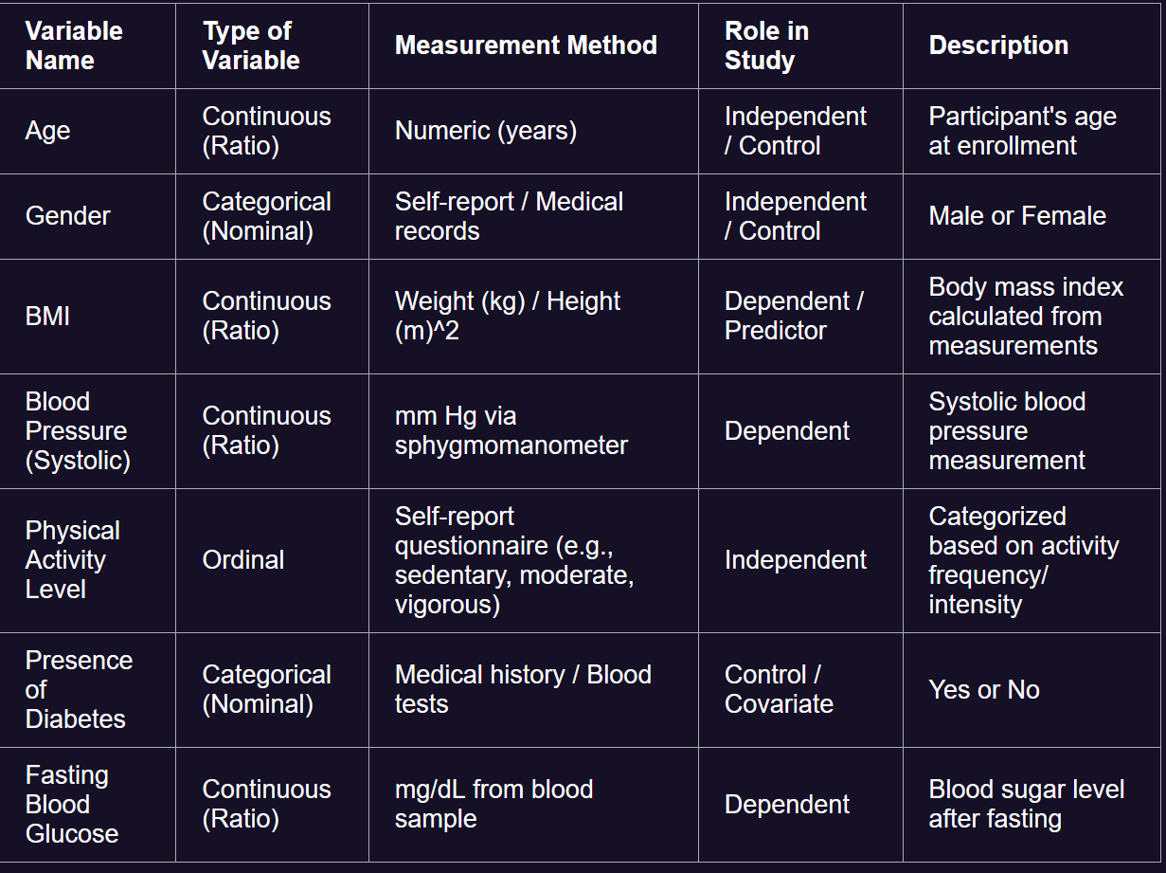
Example

Slide 10

Homework
Determine all variables that you supposed to measurement in your research.
Use table of variables

