Slide 1
Research Methods Course
Dr. Moslem Taheri Soodejani
Assistant Professor in Epidemiology
Email address: Moslem.taheri2009@yahoo.com
Healthcare Data Modeling, Departments of Biostatistics and Epidemiology, School of Public Health, Shahid Sadoughi University of Medical Sciences, Yazd, Iran
July, 2025

Slide 2

Table of contents
Title (research question)
Background
Literature review
Objectives
Study design (Epidemiological approach)
Sampling
Sample size
Data collection
Variables
Statistical analysis

Slide 3
Statistical analysis
Purpose: To interpret data accurately, determine relationships, test hypotheses, and draw valid conclusions.

Slide 4
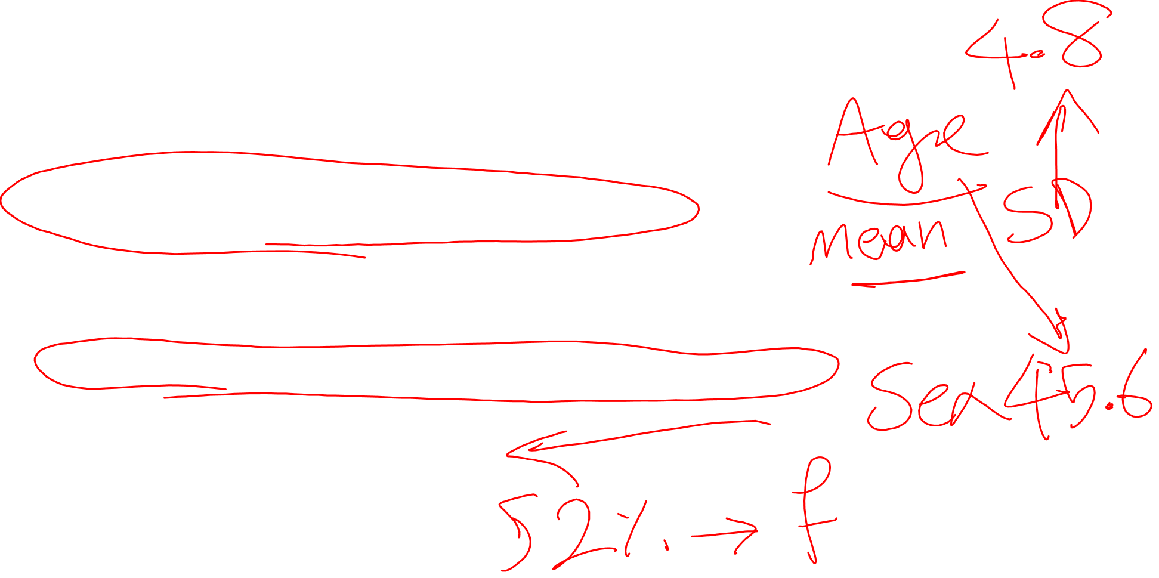
Descriptive Statistics
Summarize data using measures such as:
  Mean, median, mode (central tendency)
  Standard deviation, range, interquartile range (dispersion)
  Frequencies and percentages (categorical variables)

Slide 5
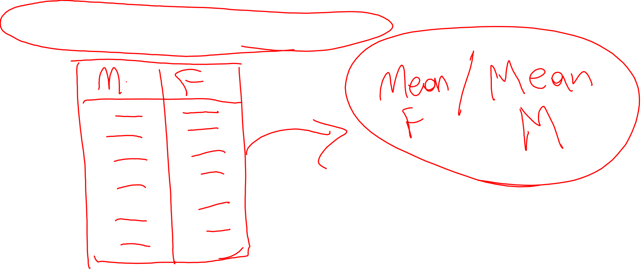
Analytical Statistics
Comparing groups:
t-test: for comparing means between two groups (e.g., treatment vs. control)
ANOVA: for comparing means among three or more groups

Slide 6

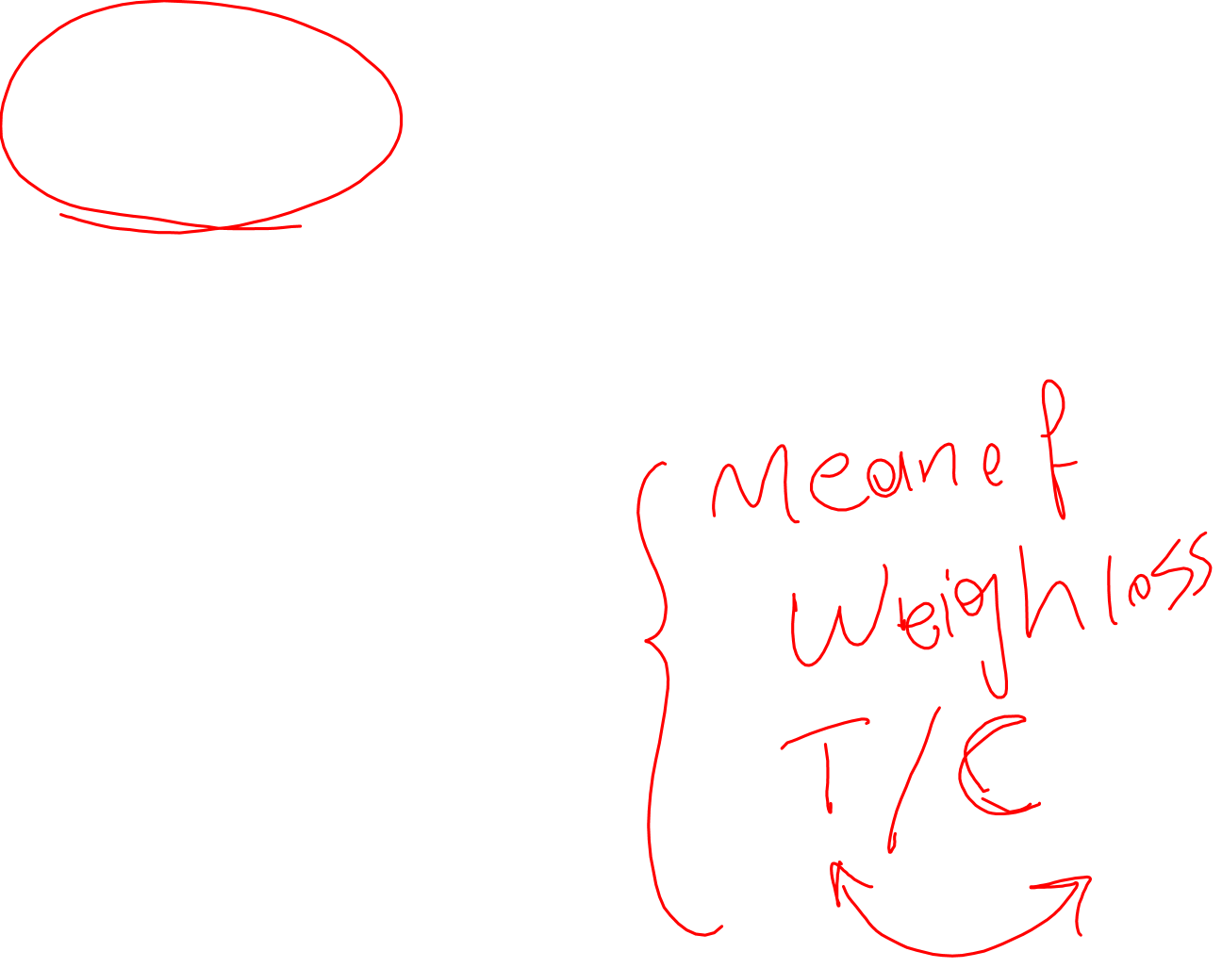
Example of a t-test
Scenario:
A researcher wants to determine if a new diet program leads to weight loss. They randomly assign 30 participants to two groups:
Treatment group: 15 participants follow the new diet
Control group: 15 participants follow their usual diet
Data collected:
The weight loss (in kg) after 8 weeks:

Slide 7
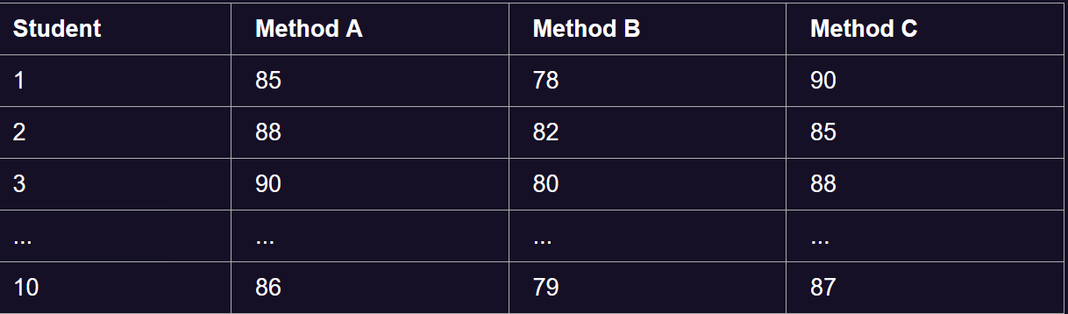

Example of ANOVA
Scenario:
A researcher wants to compare the effectiveness of three different teaching methods on student test scores.
Method A: 10 students
Method B: 10 students
Method C: 10 students
Test scores (out of 100):

Slide 8
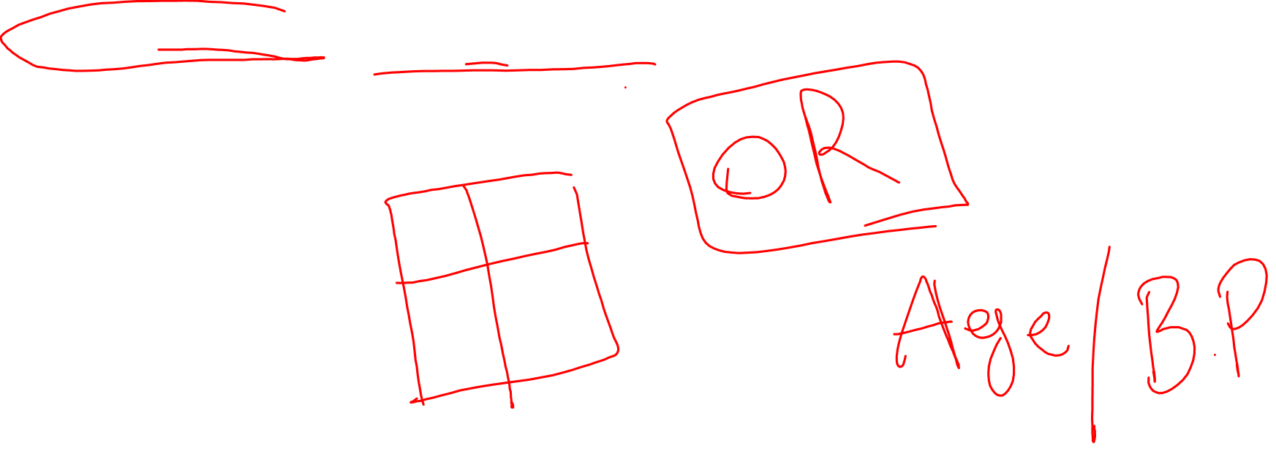
Analytical statistics
Associations:
Chi-square test: for relationships between categorical variables
Correlation coefficient (Pearson or Spearman): for assessing strength of association between two continuous variables

Slide 9
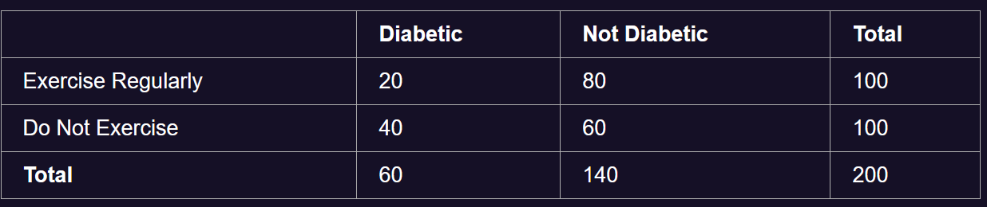
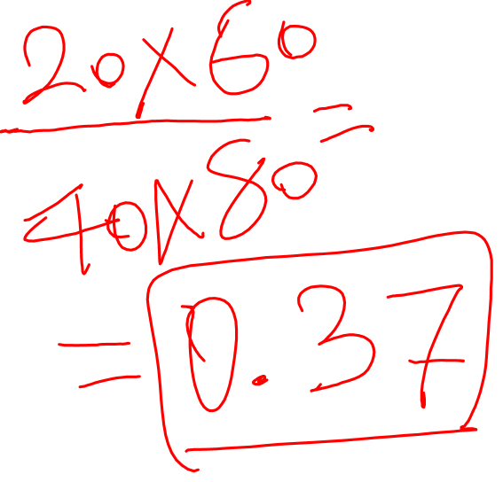
Example of Chi-square test
Scenario:
A health researcher wants to investigate whether there is an association between exercise habits (Exercise Regularly or Not) and diabetes status (Diabetic or Not).

Slide 10
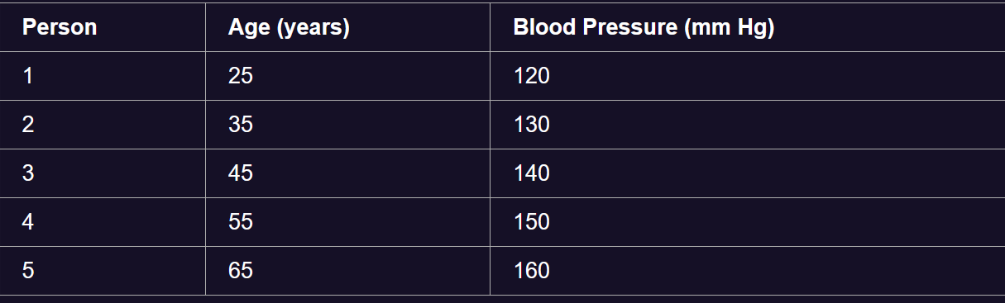
Scenario:
A researcher wants to examine if there is a relationship between age and systolic blood pressure in adults.

Slide 11
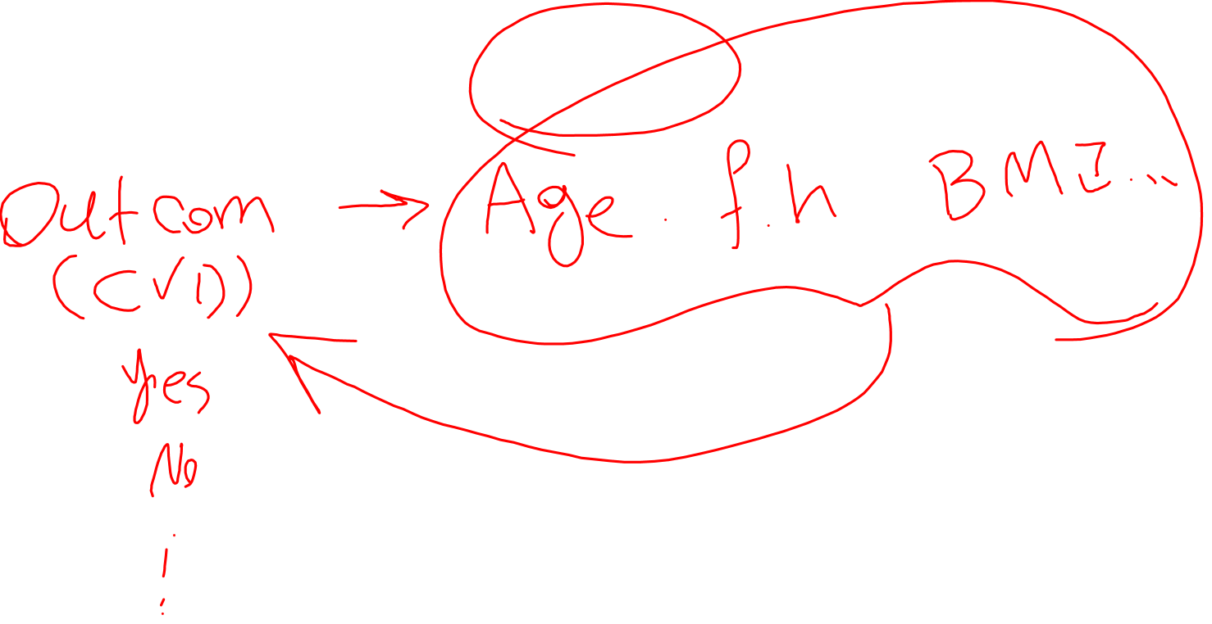
Analytical statistics
Regression analysis:
Linear regression: for predicting a continuous outcome
Logistic regression: for predicting a binary outcome (e.g., disease presence)

Slide 12
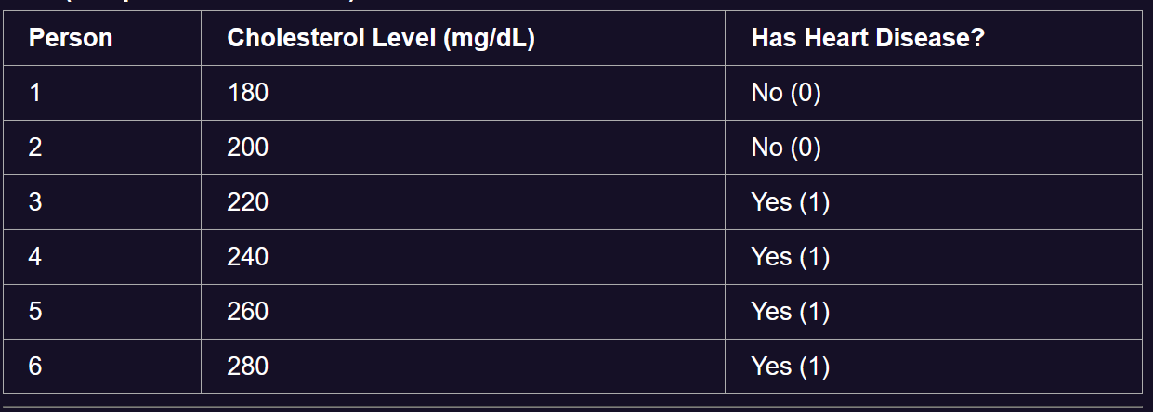
Example of Logistic Regression:
Scenario:
A healthcare researcher wants to predict the likelihood of having heart disease based on cholesterol level.

Slide 13
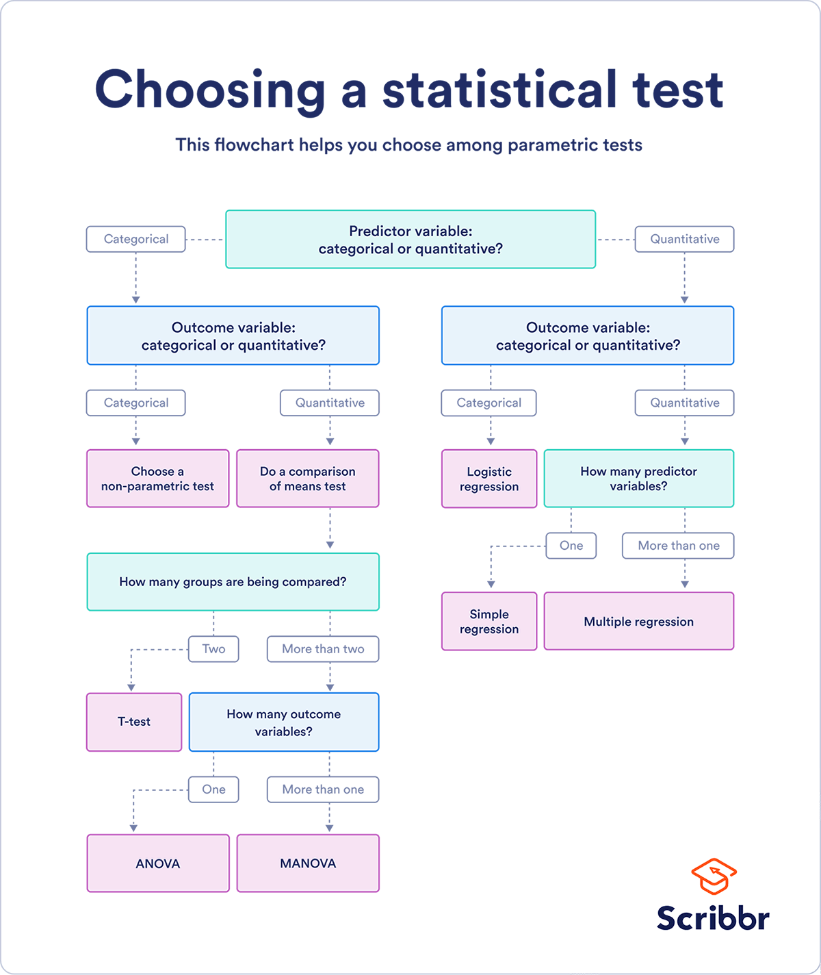

Slide 14
Homework
Select statistical analyses for your research.

