Slide 1
Research Methods Course
Dr. Moslem Taheri Soodejani
Assistant Professor in Epidemiology
Email address: Moslem.taheri2009@yahoo.com
Healthcare Data Modeling, Departments of Biostatistics and Epidemiology, School of Public Health, Shahid Sadoughi University of Medical Sciences, Yazd, Iran
July, 2025

Slide 2

Table of contents
Title (research question)
Background
Literature review
Objectives
Study design (Epidemiological approach)
Sampling
Sample size
Data collection
Variables
Statistical analysis

Slide 3

Epidemiology studies
Epidemiological studies are research investigations that examine the distribution, determinants, and health outcomes in populations. They help identify risk factors, causes of diseases, and inform public health interventions.

Slide 4

Types of Epidemiological Studies
Descriptive Studies
Purpose: Describe the distribution of diseases or health outcomes by person, place, and time.
Examples: Case reports, case series, cross-sectional studies.
Analytical Studies
Purpose: Investigate associations and causes.

Slide 5

Type of analytical studies
1. Observational Studies: No intervention by researchers.
  Cohort Studies: Follow groups over time to see who develops the disease.
  Case-Control Studies: Compare those with the disease (cases) to those without (controls).
  Cross-Sectional Studies: Snapshot at a single point in time.
2. Experimental Studies: Researchers assign interventions.
  Randomized Controlled Trials (RCTs): Participants randomly assigned to intervention or control.

Slide 6

Descriptive study
Definition:
A descriptive epidemiology study focuses on characterizing the distribution of health outcomes or diseases within a population. It addresses the "who," "where," and "when" aspects without necessarily investigating causes.

Slide 7
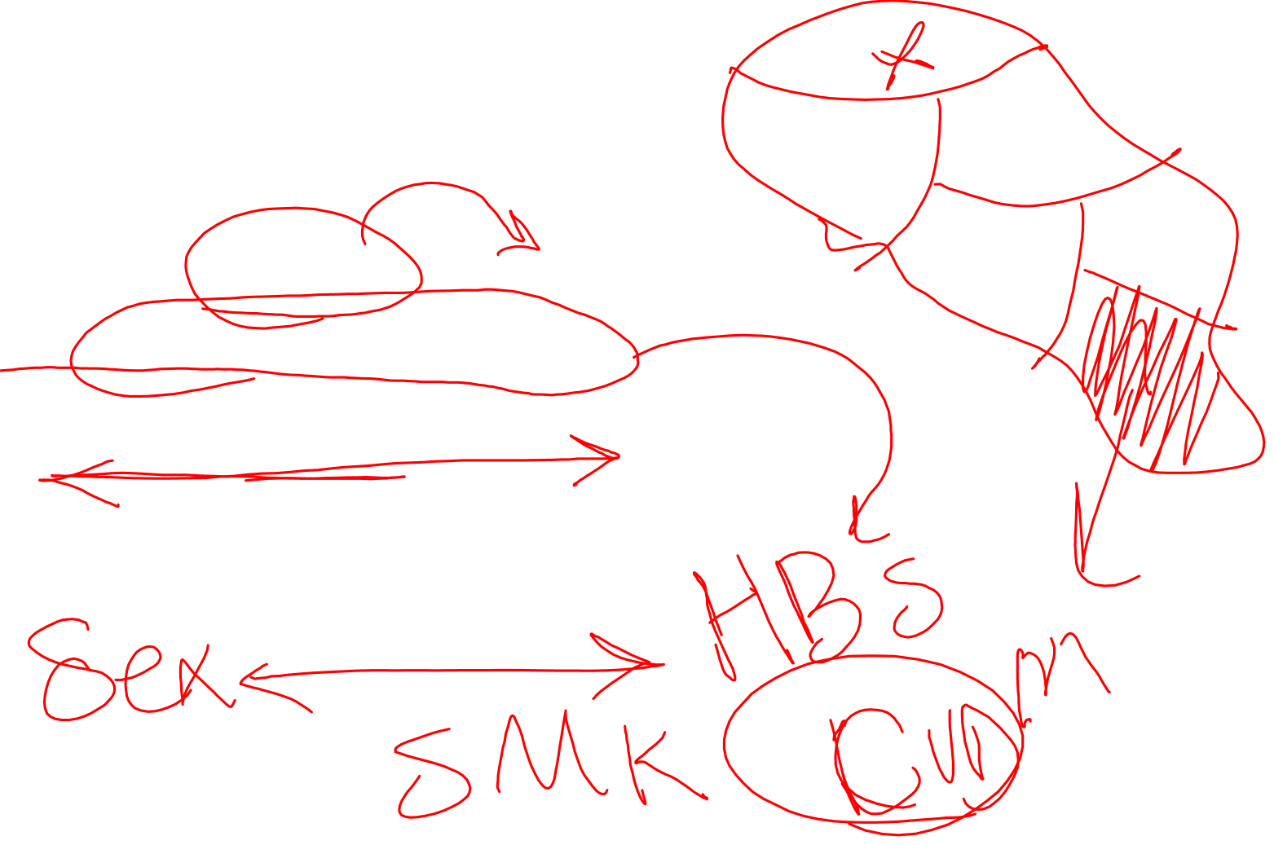
Descriptive study
Purpose
To determine the patterns of disease occurrence.
To identify subgroups at higher risk.
To generate hypotheses about potential risk factors.

Slide 8

Descriptive study
Key Components
Person:
  Age, sex, ethnicity, occupation, socioeconomic status, etc.
Place:
  Geographic location (city, region, country), urban vs. rural.
Time:
  Calendar period, seasonality, trends over years.

Slide 9
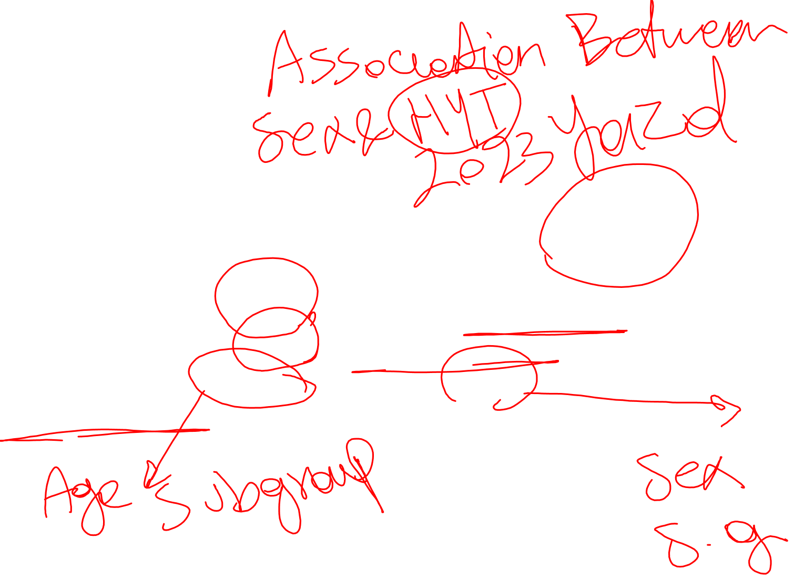
Descriptive study
Example of a Descriptive Study
Title:
"Prevalence of Hypertension in Adults Aged 30-60 in Urban Area X"
Description:
Researchers conduct a survey in 2023, measuring blood pressure in 1,000 residents. They report that 15% have hypertension, with higher prevalence among those aged 50-60 and among males. The data helps identify high-risk groups and informs public health planning.

Slide 10

Descriptive study
Importance
Descriptive studies are crucial for public health planning and resource allocation. They help identify patterns that can lead to hypothesis generation for further analytical studies.

Slide 11
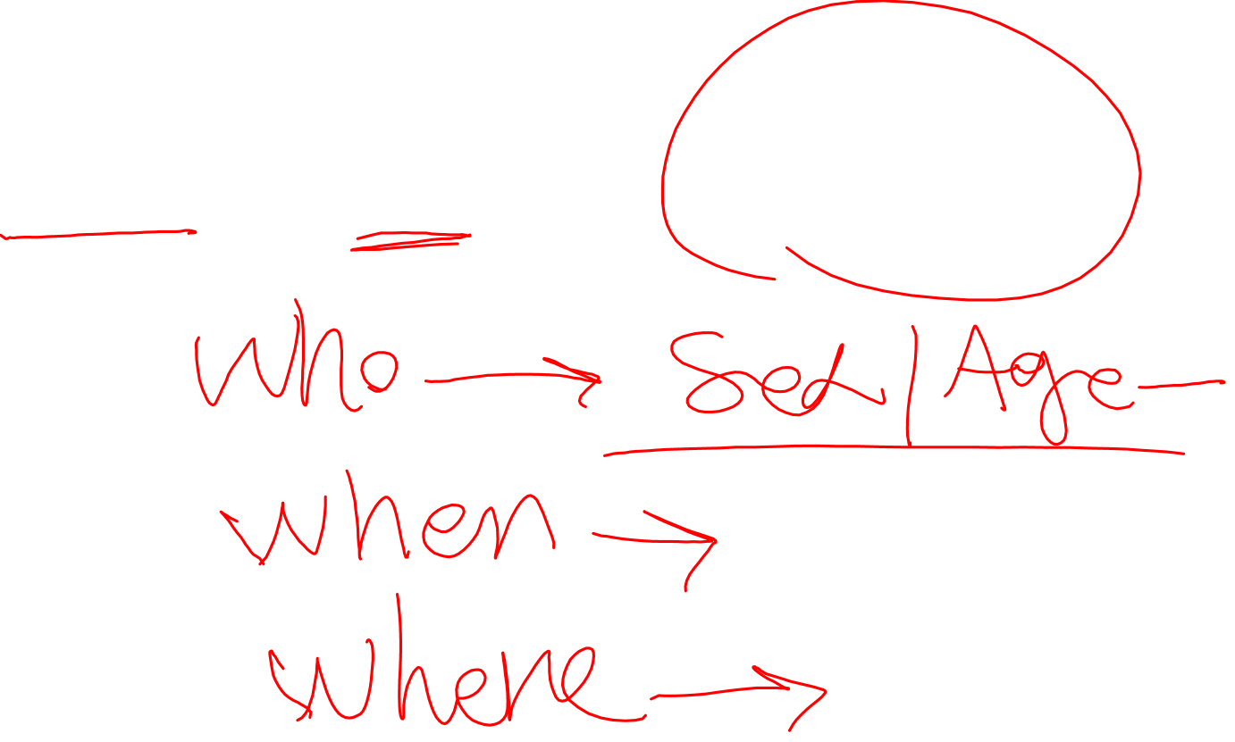
Homework
Find and check a paper that was conducted with descriptive study design.

