Slide 1
Research Methods Course
Dr. Moslem Taheri Soodejani
Assistant Professor in Epidemiology
Email address: Moslem.taheri2009@yahoo.com
Healthcare Data Modeling, Departments of Biostatistics and Epidemiology, School of Public Health, Shahid Sadoughi University of Medical Sciences, Yazd, Iran
July, 2025

Slide 2

Table of contents
Title (research question)
Background
Literature review
Objectives
Study design (Epidemiological approach)
Sampling
Sample size
Data collection
Variables
Statistical analysis

Slide 3

Cross-sectional studies
A cross-sectional study is an observational research design that examines data from a population or a representative subset at a single point in time. It provides a "snapshot" of the prevalence of a disease or health-related characteristics.

Slide 4
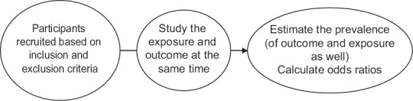
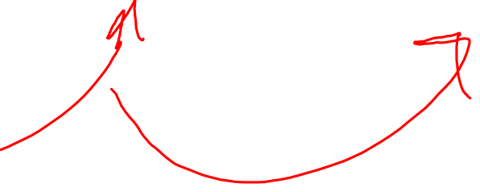
Cross-sectional design

Slide 5

Examples of Cross-Sectional Studies
Antibiotic resistance in Propionibacterium acnes strains (Sardana et al., 2016)
A study by Sardana et al. evaluated the antibiotic resistance in isolates of Propionibacterium acnes in a tertiary care hospital in India. They recruited 80 patients of acne vulgaris, collected specimen for isolation from open or closed comedones. These specimens were then cultured, the growth identified, and antibiotic susceptibility and resistance were assessed.

Slide 6
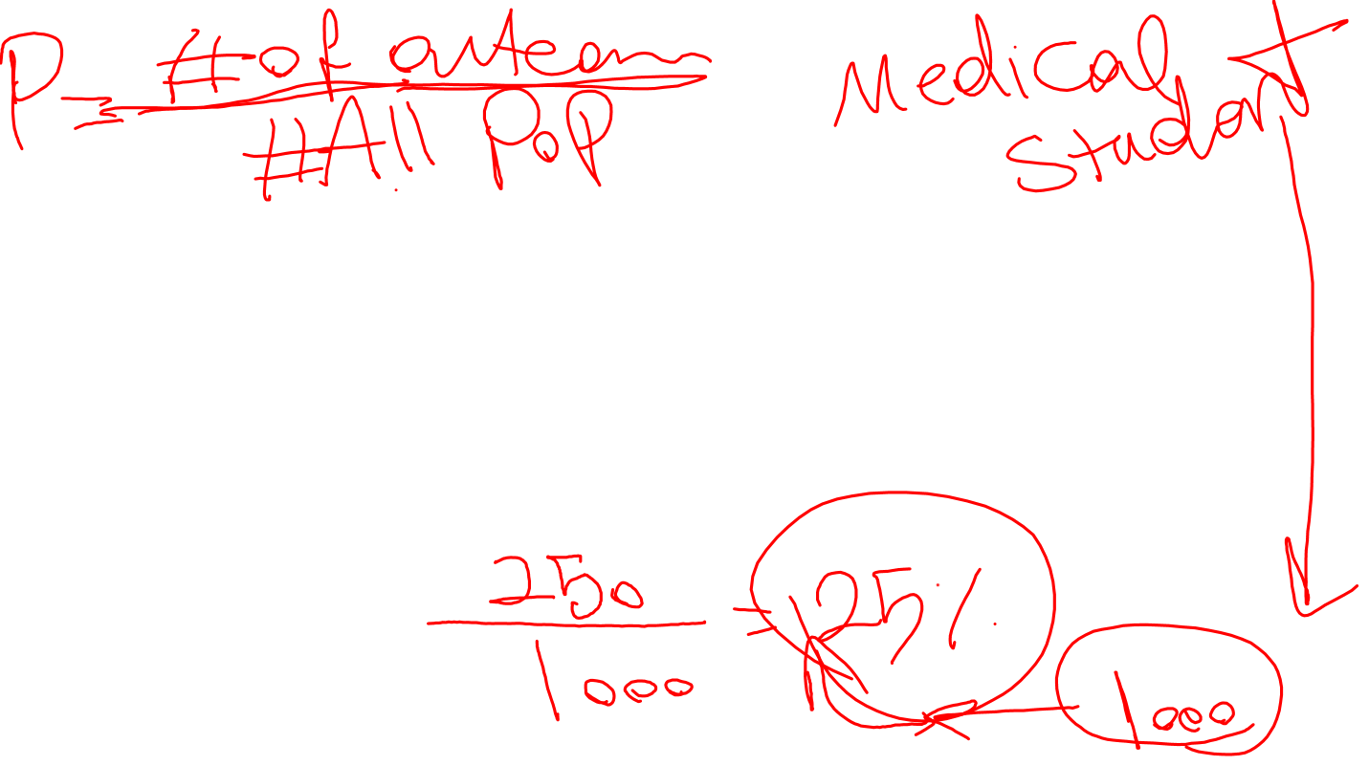
Measurements in a Cross-sectional Study
1. Cross-sectional study designs may be used for population-based surveys
Example: We are interested to know the prevalence of vitiligo in a village. We design a population-based survey to assess the prevalence of this condition. We go to all the houses that were supposed to be included in the study and examine the population. The total sample surveyed is 5686. Of these, we found that 98 individuals have vitiligo. Thus, the prevalence of vitiligo in this community is: Prevalence = 98/5686 or 17.23/1000 population

Slide 7

Measurements in a Cross-sectional Study
2. Cross-sectional studies may also be used for estimating the prevalence in clinic-based studies.
Example: Research question – What is the prevalence of HIV in patients presenting with an STI?
We evaluate 300 patients with an STI clinic. We record this history, clinical examination, and test them for HIV antibodies (using ELISA) during their first visit to the clinic. We find that 60 of these individuals are HIV infected. Thus, we have detected a prevalence of 20% HIV infection among our STI patients. This type of study will be classified as a cross-sectional study. Kindly note that this being a clinic-based study, it may have all the limitations of a clinic-based study. Thus, the prevalence from these data may have limited generalizability. Nonetheless, this type of study design will be classified as a cross-sectional study.

Slide 8
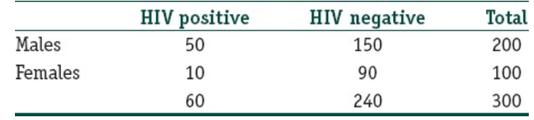

Measurements in a Cross-sectional Study
3. Cross-sectional studies may also be used to calculate the ORs
For example, if we wish to understand the association between gender and HIV status, we will able to create a 2 × 2 table for the above-mentioned cross-sectional study. Of the 300 individuals evaluated, we have recruited 200 male and 100 female participants. Of the 60 HIV-infected individuals, 50 are males and 10 are females.

Slide 9

Strengths of a Cross-sectional Study
Cross-sectional studies can usually be conducted relatively faster and are inexpensive – particularly when compared with cohort studies (prospective)
These are studies are conducted either before planning a cohort study or a baseline in a cohort study. These types of designs will give us information about the prevalence of outcomes or exposures; this information will be useful for designing the cohort study
These study designs may be useful for public health planning, monitoring, and evaluation. For example, sometimes the National AIDS Programme conducted cross-sectional sentinel surveys among high-risk groups and ante-natal mothers every year to monitor the prevalence of HIV in these groups.

Slide 10
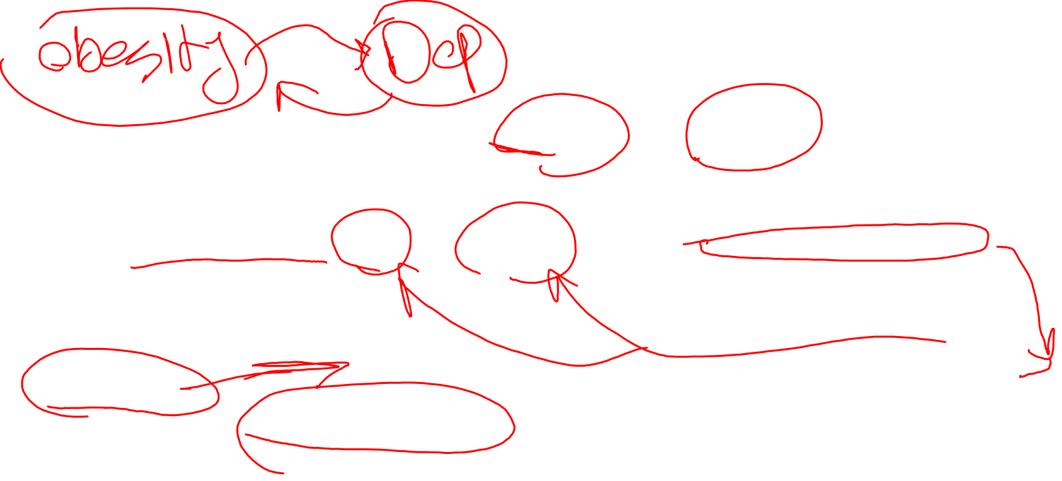
Limitations of a Cross-sectional Study
Since this is a 1-time measurement of exposure and outcome, it is difficult to derive causal relationships from cross-sectional analysis
These studies are also prone to certain biases. For example, we wish to study the relation between diet and exercise and being overweight/obese. We conduct a cross-sectional study and recruit 250 individuals. We assess their dietary habits, exercise habits, and body mass index at one point of time in a cross-sectional survey.
The prevalence of an outcome depends on the incidence of the disease as well as the length of survival following the outcome. For example, even if the incidence of HIV (number of new cases) goes down in one particular community, the prevalence (total number of cases – old as well as new) may increase.

Slide 11
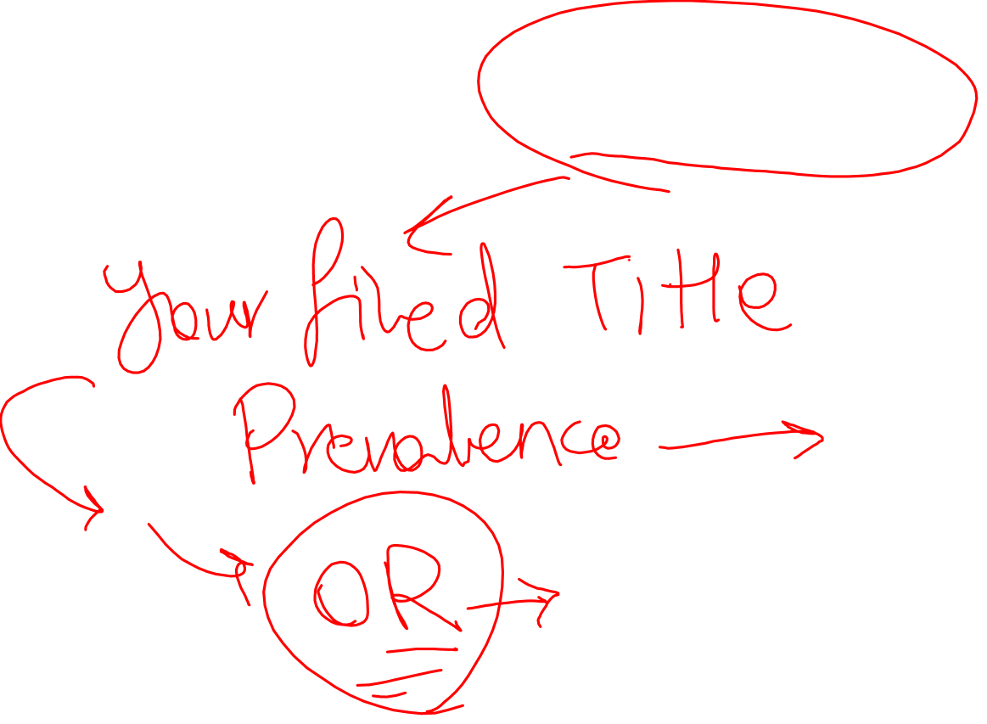
Homework
Find and check a paper that was conducted with Cross-sectional design.

