Slide 1
Research Methods Course
Dr. Moslem Taheri Soodejani
Assistant Professor in Epidemiology
Email address: Moslem.taheri2009@yahoo.com
Healthcare Data Modeling, Departments of Biostatistics and Epidemiology, School of Public Health, Shahid Sadoughi University of Medical Sciences, Yazd, Iran
July, 2025

Slide 2

Table of contents
Title (research question)
Background
Literature review
Objectives
Study design (Epidemiological approach)
Sampling
Sample size
Data collection
Variables
Statistical analysis

Slide 3

Case Control Study
Case-control studies are observational studies, where two groups determine the level of exposure to a risk or a disease, by identifying a group of individuals with disease and for purpose of comparison, a group of people without the disease.
The investigator collects retrospective information about exposure to the risk factor from both groups.
Case-control studies identify subjects by outcome.
Subjects with disease (or outcome) are called cases and subjects without disease (or outcome) are called controls.

Slide 4
Design of a case-control study
Study hypothesis
A specific hypothesis is the first and most important step in an epidemiologic study design.
It must be clearly stated prior to the design of the case–control study.
Poor hypotheses lead to poor study design and problems in interpretation of results.

Slide 5
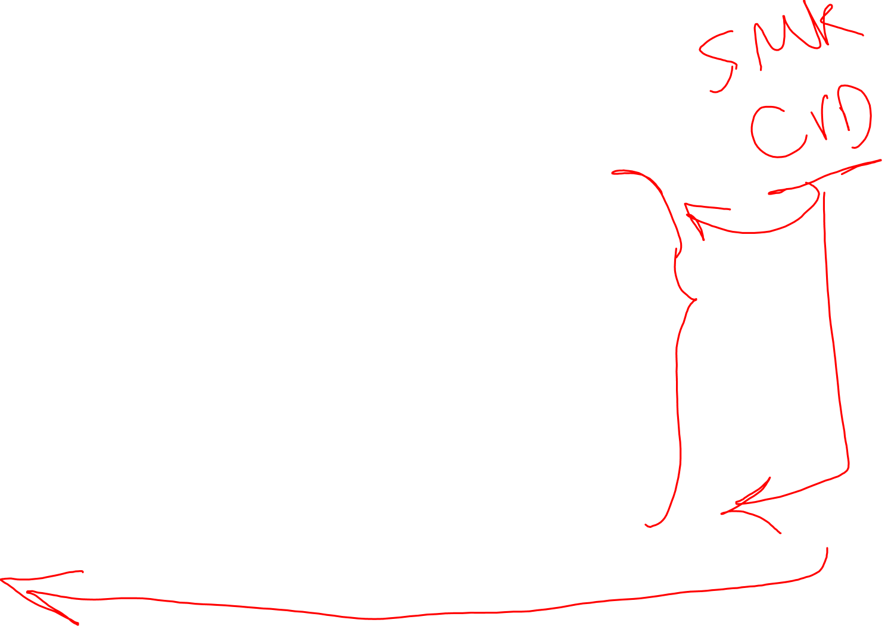
Case-Control study design
Exposed
Cases (ill)
Not Exposed
Exposed
Control (Not ill)
Not Exposed

Slide 6
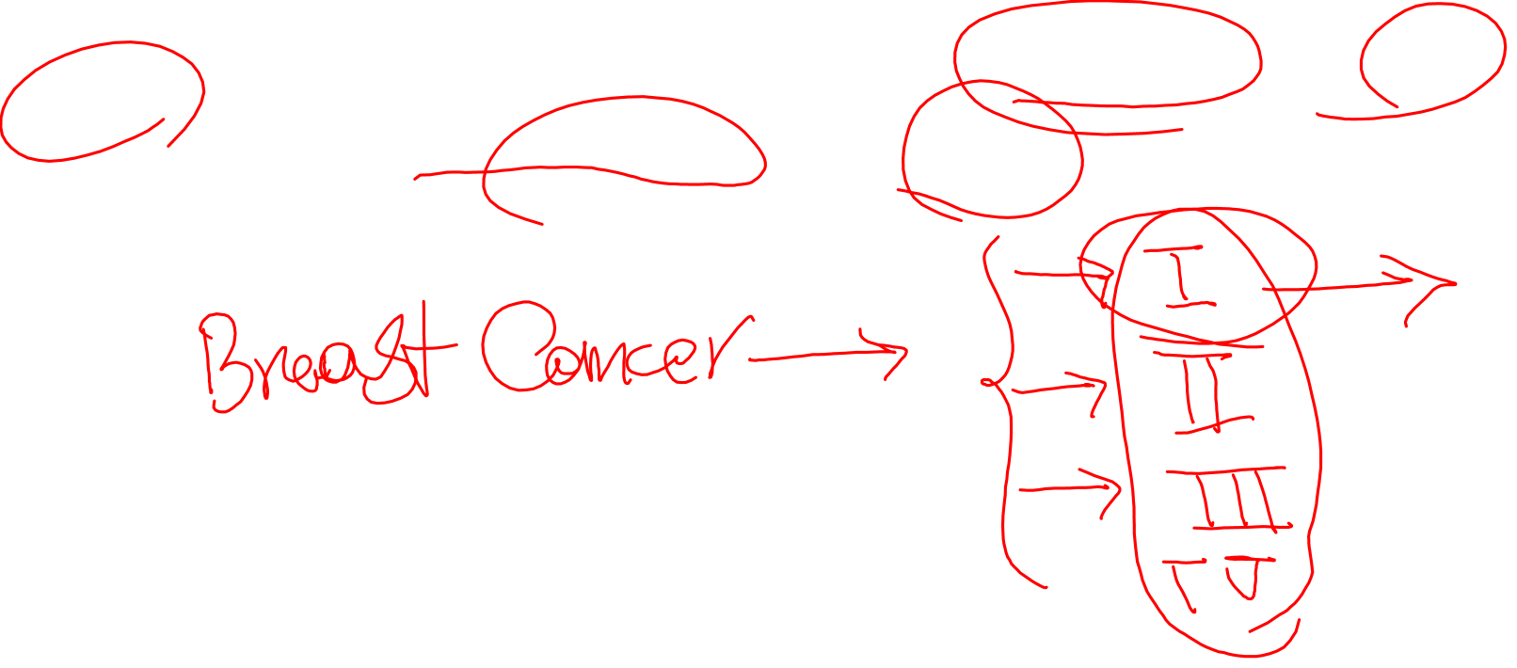
Definition and selection of cases
Case definition, based on precise and objective criteria is essential. For example, a histologically confirmed diagnosis should be required for most cancers.
With precise case definitions, the investigator avoids ambiguity about types of cases and stages of disease to be included or excluded from the study.
In case-control studies, the investigator should clearly define the eligibility criteria for both cases and controls (inclusion and exclusion criteria).
It is important to select both cases and controls from the same source of the population. This help to maximize the chance of detecting important association.

Slide 7
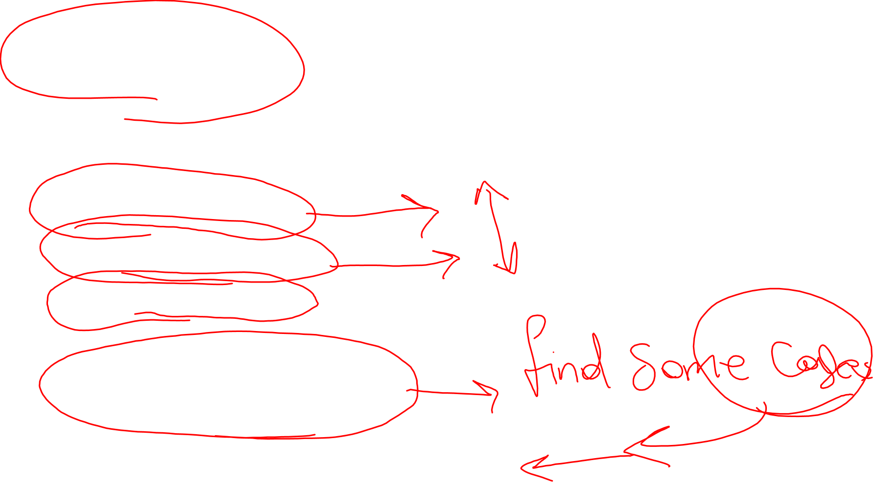
Source of cases
Patient attending health facilities
Medical records
Death certificates
Disease registries (e.g., cancer or birth defect registries)
Cross-sectional surveys

Slide 8
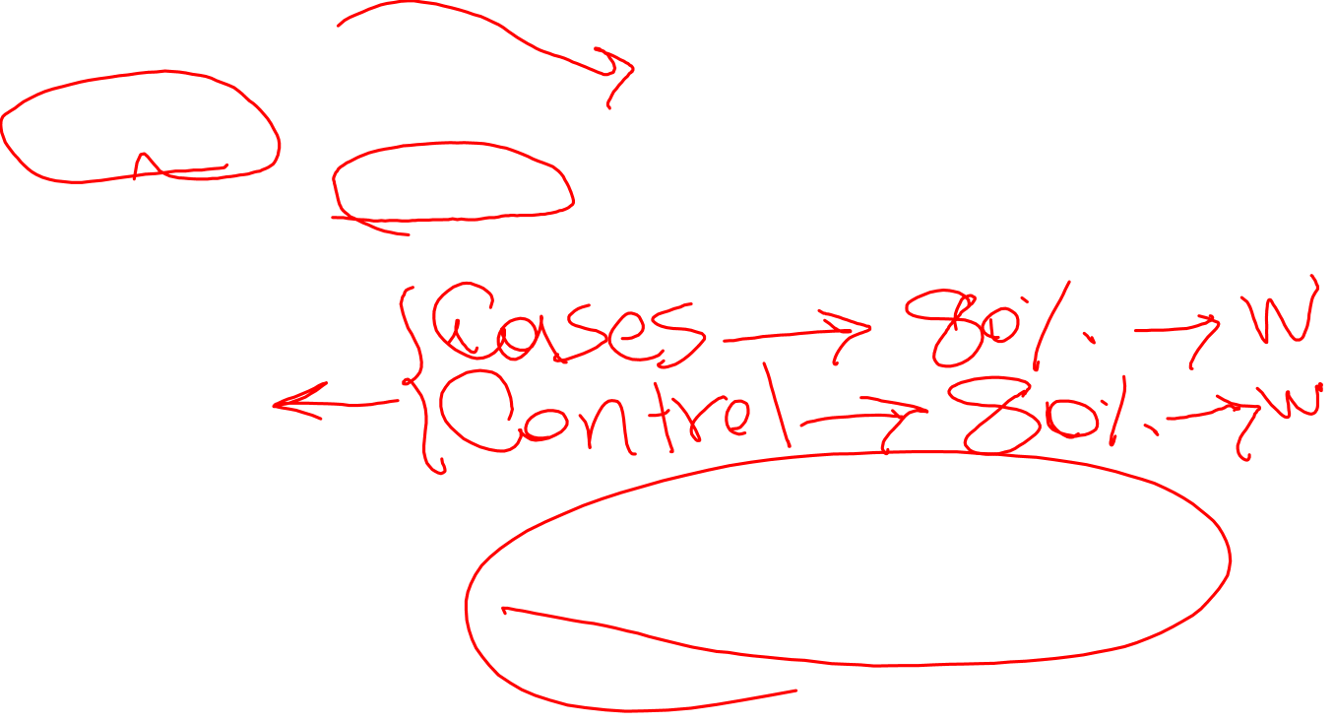
Definition and selection of controls
Controls must fulfil the same eligibility criteria defined for the cases, with the exception of the disease (outcome). For example, if the cases are women with cervical cancer, over 50 years-old and more, the controls must be selected from women in the same age group without the disease.
Source of controls
Controls should be selected from the population from which the cases are selected. This helps to provide an estimate of the exposure prevalence in the population from which the cases arise.

Slide 9
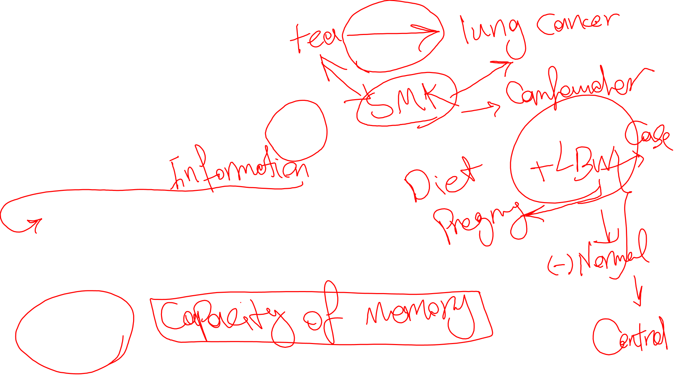
Biases in case-control studies
Selection bias
Selection bias occurs when the subjects in one group are different, or the cases and controls are not comparable (other than disease). In order to prevent this bias, precise selection criteria should be defined for both cases and controls.
Ascertainment bias
It may happen because:
Cases may recall exposure better than the controls
Investigators may search for exposure better in cases than in control.
Limitations for recalling past events
In case-control studies much data is collected from interviews. Human beings differ in their capacity to recall information. As mentioned above, cases may have better recall than controls. It is also possible that the person may not have the information requested.
Confounding
It occurs when the observed result between exposure and disease is distorted because of the influence of the third variable.

Slide 10
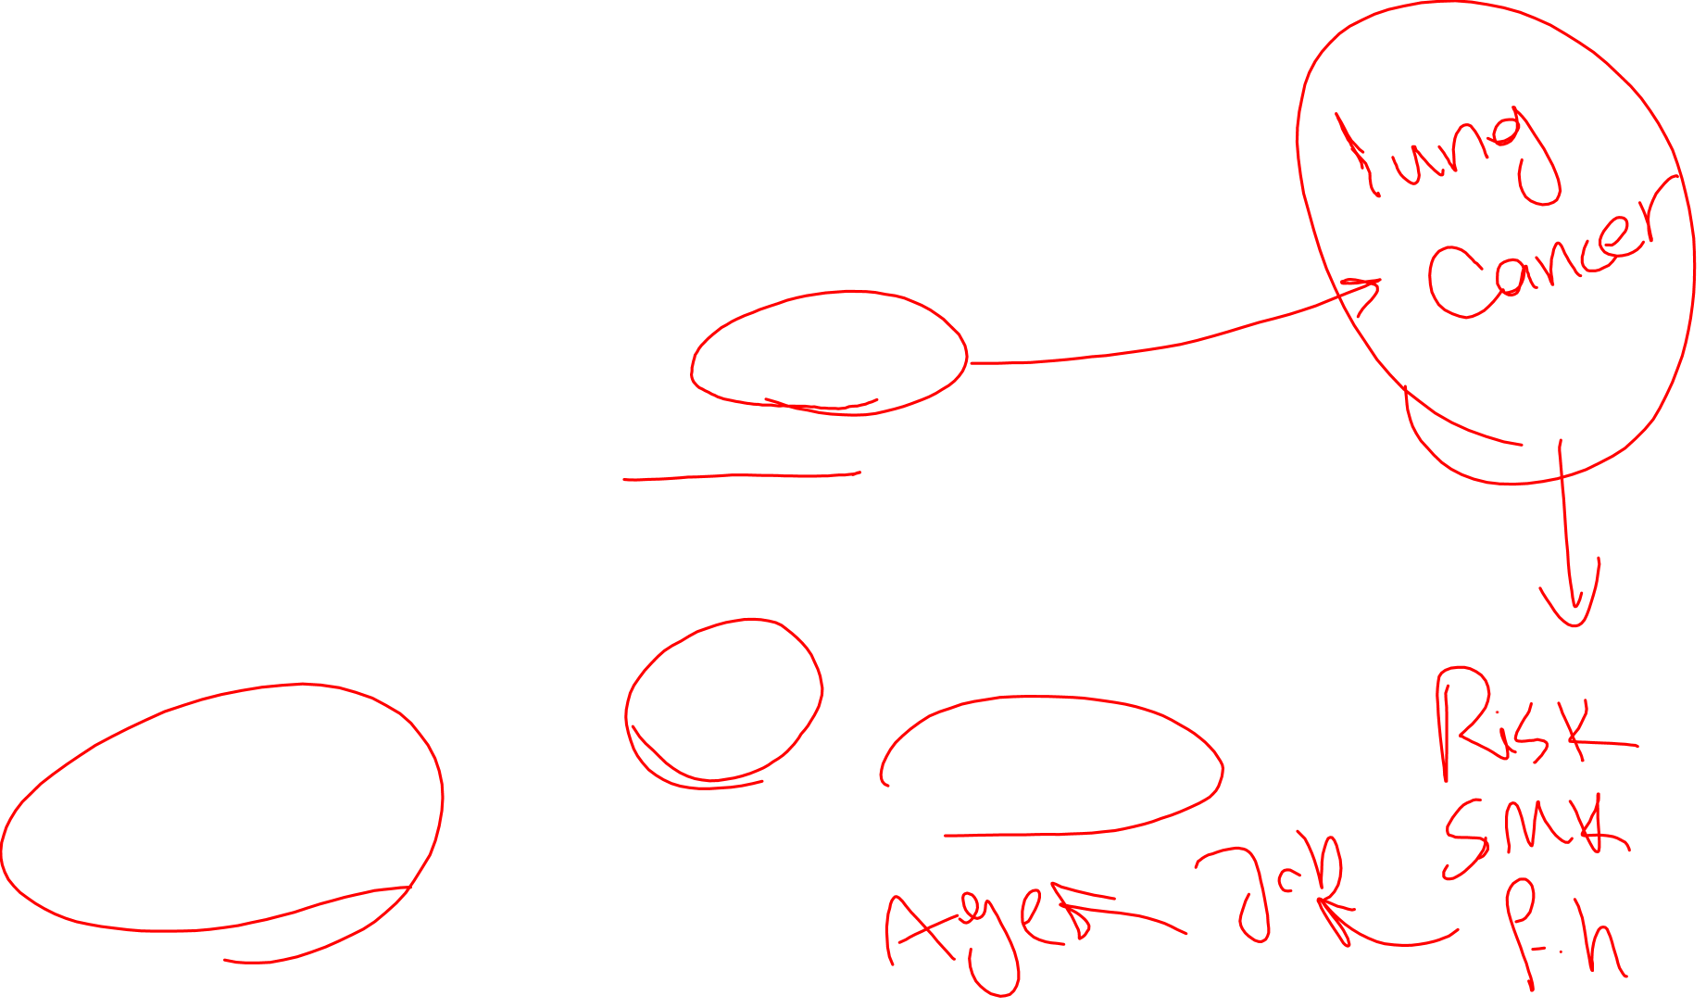
Strengths and weaknesses of case-control studies
Strengths
Case-control studies cost less than other studies, e.g. cohort studies.
Case-control studies are mostly retrospective; cases are identified at the beginning. There is no need to follow cases over a period of time, unlike cohort studies.
Case-control studies are more appropriate for rare diseases.
The association between diseases and multiple exposures can be studied at the same time.
Weaknesses
Case-controls are subject to multiple biases (especially selection and recall biases).
Case-control studies cannot estimate the incidence rate unless the rates are population based.
Case-control studies are difficult for determining the time period between the exposure and disease.

Slide 11
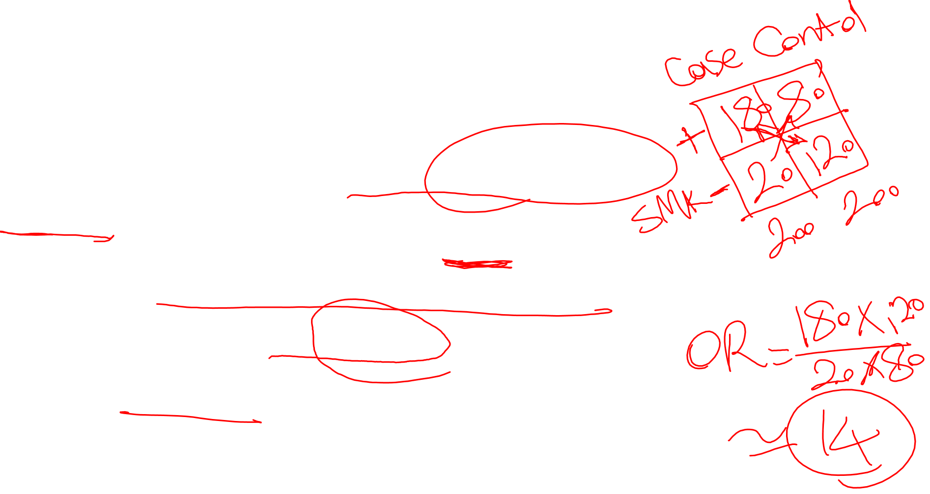
Example
Study Title:
"Association Between Smoking and Lung Cancer: A Case-Control Study"
Objective:
To investigate whether smoking is associated with an increased risk of developing lung cancer.
Study Design:
Cases: 200 individuals diagnosed with lung cancer, identified from hospital records.
Controls: 200 individuals without lung cancer, matched to cases by age, sex, and residence, selected from the community.
Method:
Researchers collected data through interviews and questionnaires, asking participants about their smoking history, including duration and intensity. They then compared the prevalence of smoking between cases and controls.
Results:
180 of the 200 lung cancer cases were current or former smokers.
80 of the 200 controls were smokers.
Analysis:
The odds ratio (OR) for smoking among cases versus controls was calculated, showing a significant association between smoking and lung cancer.
Conclusion:
The study suggests that smoking is strongly associated with an increased risk of lung cancer.
This example illustrates how a case-control study compares exposure (smoking) between those with the disease (cases) and those without (controls) to identify potential risk factors.

Slide 12
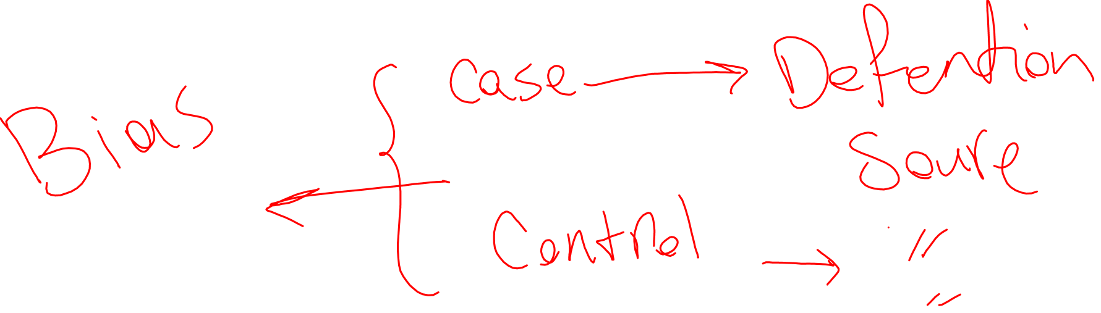
Homework
Find and check a paper that was conducted with case-control design.

