Slide 1
Research Methods Course
Dr. Moslem Taheri Soodejani
Assistant Professor in Epidemiology
Email address: Moslem.taheri2009@yahoo.com
Healthcare Data Modeling, Departments of Biostatistics and Epidemiology, School of Public Health, Shahid Sadoughi University of Medical Sciences, Yazd, Iran
July, 2025

Slide 2

Table of contents
Title (research question)
Background
Literature review
Objectives
Study design (Epidemiological approach)
Sampling
Sample size
Data collection
Variables
Statistical analysis

Slide 3
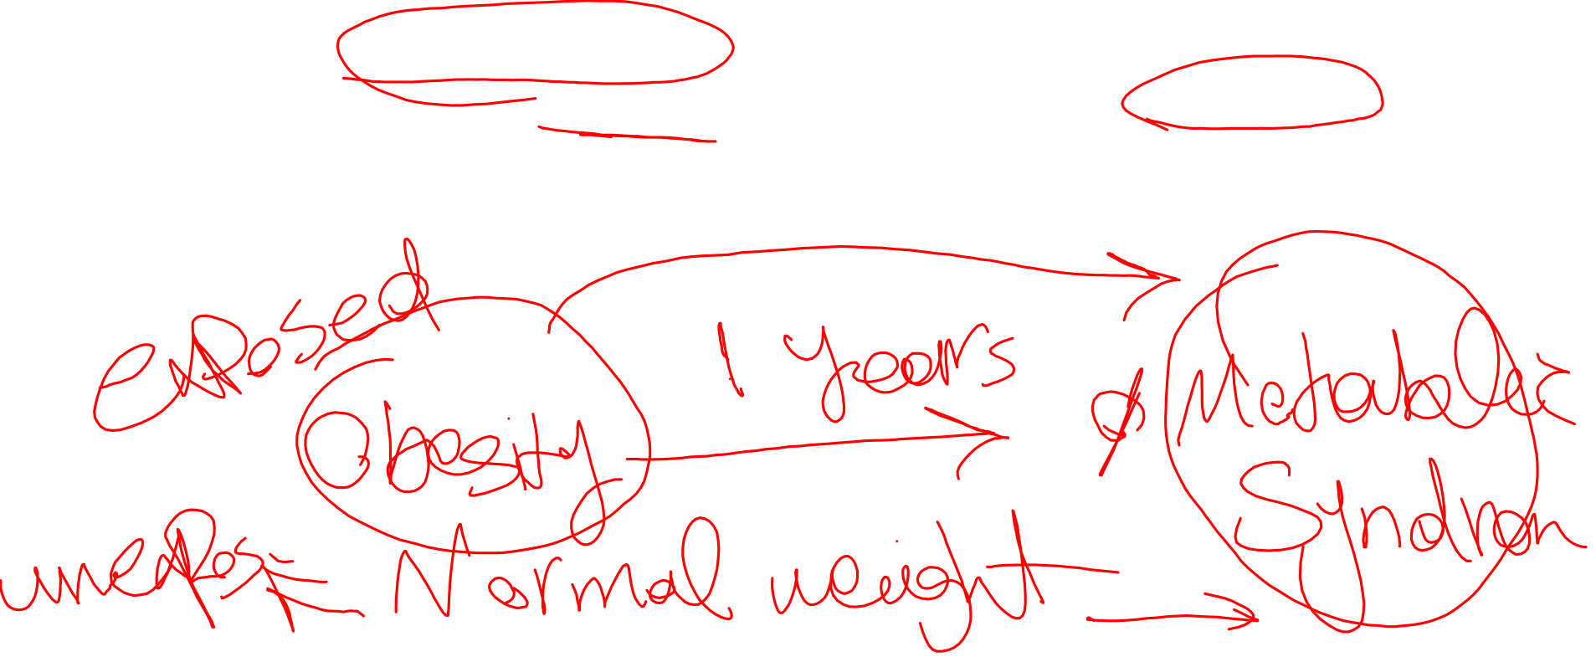
Cohort Study
A cohort study is a type of observational study that follows a group of participants over a period of time, examining how certain factors (like exposure to a given risk factor) affect their health outcomes. The individuals in the cohort have a characteristic or lived experience in common, such as birth year or geographic area.

Slide 4
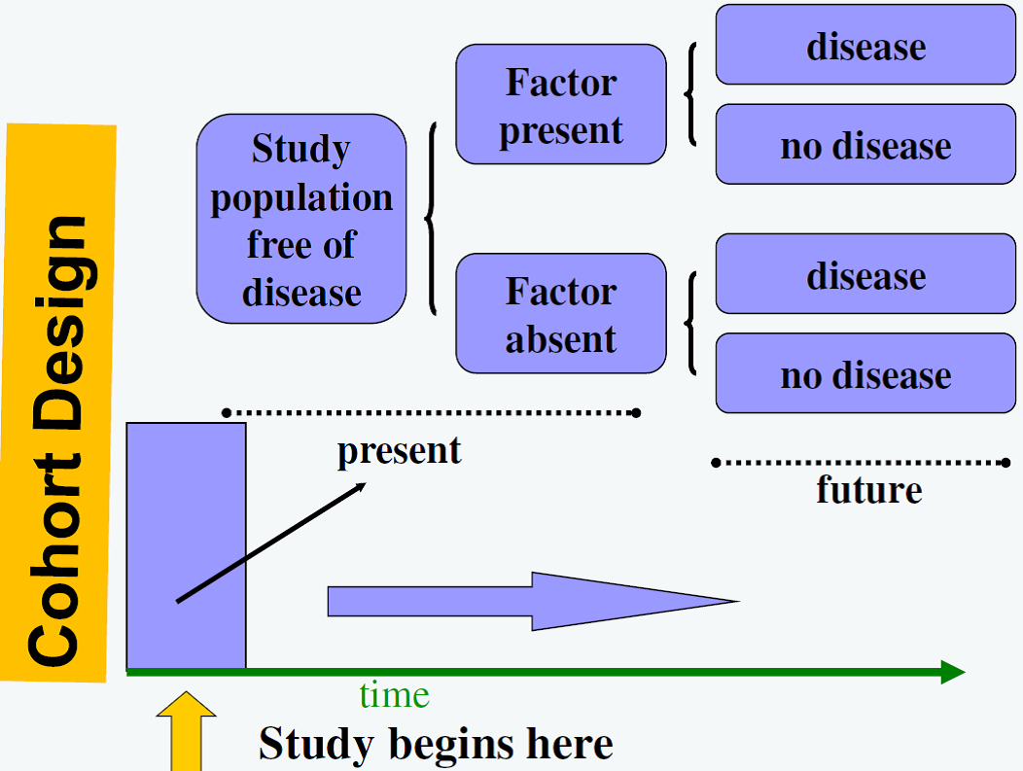

Cohort study design

Slide 5
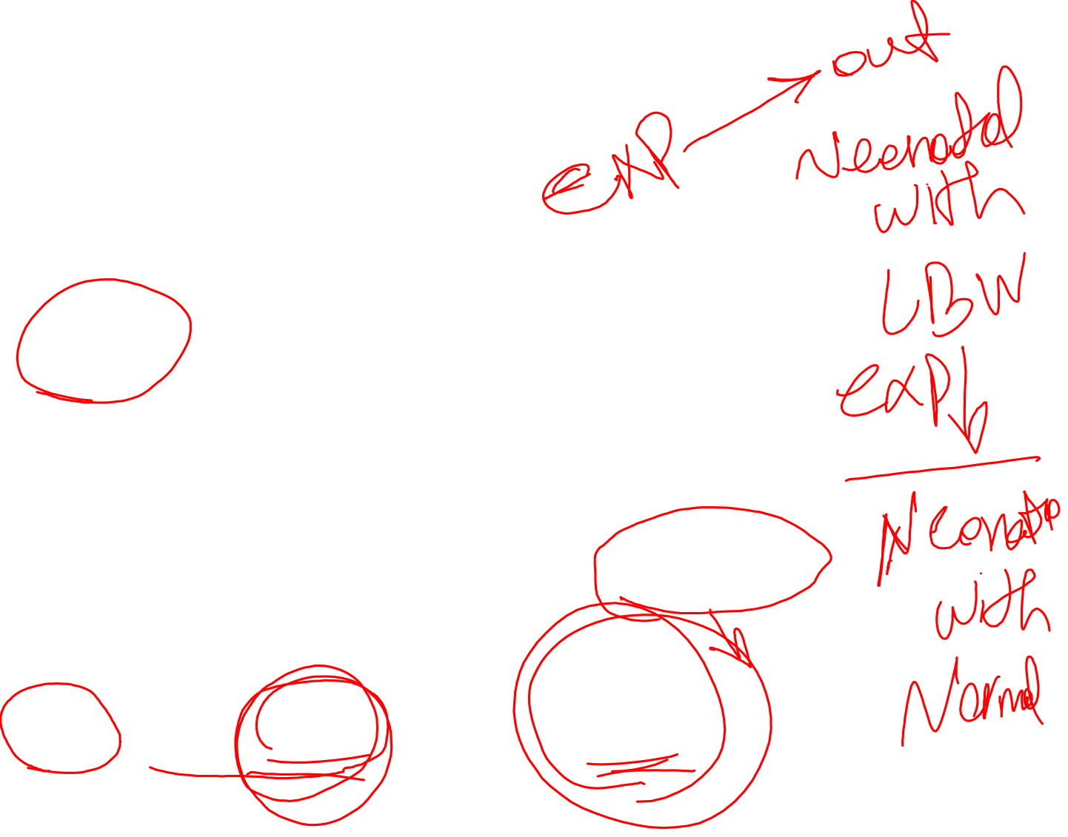
Key Features of Cohort Studies
Selection of a Cohort:
A group of individuals who share a common characteristic or experience at the start (e.g., exposure to a risk factor) and are free of the outcome of interest.
Exposure Assessment:
The cohort is classified based on exposure status (exposed vs. unexposed) to a specific factor (e.g., smoking, chemical exposure).
Follow-Up Over Time:
Participants are observed over a period, during which data on new cases of the outcome (e.g., disease) are collected.
Comparison of Incidence:
The incidence rates of outcomes are compared between exposed and unexposed groups to assess associations.
Temporal Sequence:
Since data on exposure are collected before the outcome occurs, cohort studies can establish a temporal relationship between exposure and disease.
Multiple Outcomes:
They allow investigation of multiple health outcomes related to a single exposure.
Longitudinal Design:
They involve tracking participants over time, which can be prospective (forward-looking) or retrospective (using existing records).

Slide 6
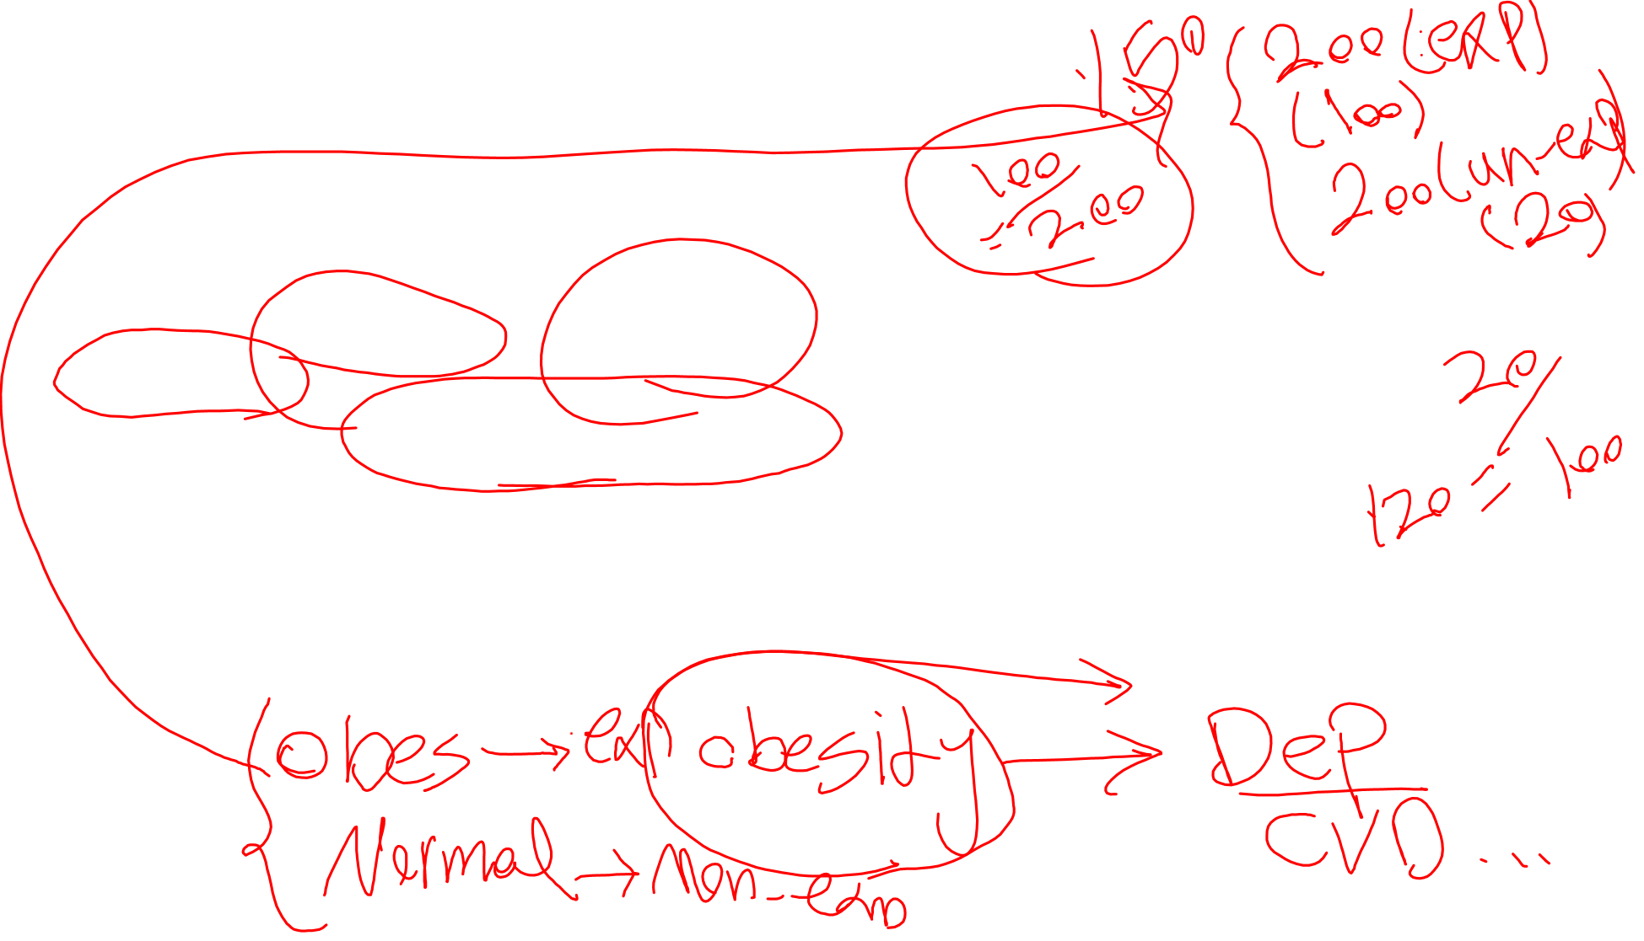
Strengths of Cohort Studies:
Can establish temporal relationship: Cohort studies can show if the exposure precedes the outcome, which is crucial for establishing causality.
Can study multiple outcomes: Researchers can examine the relationship between a single exposure and multiple outcomes.
Can assess incidence: Cohort studies can measure the incidence of the outcome (the rate at which it occurs) in different exposed and unexposed groups.

Slide 7
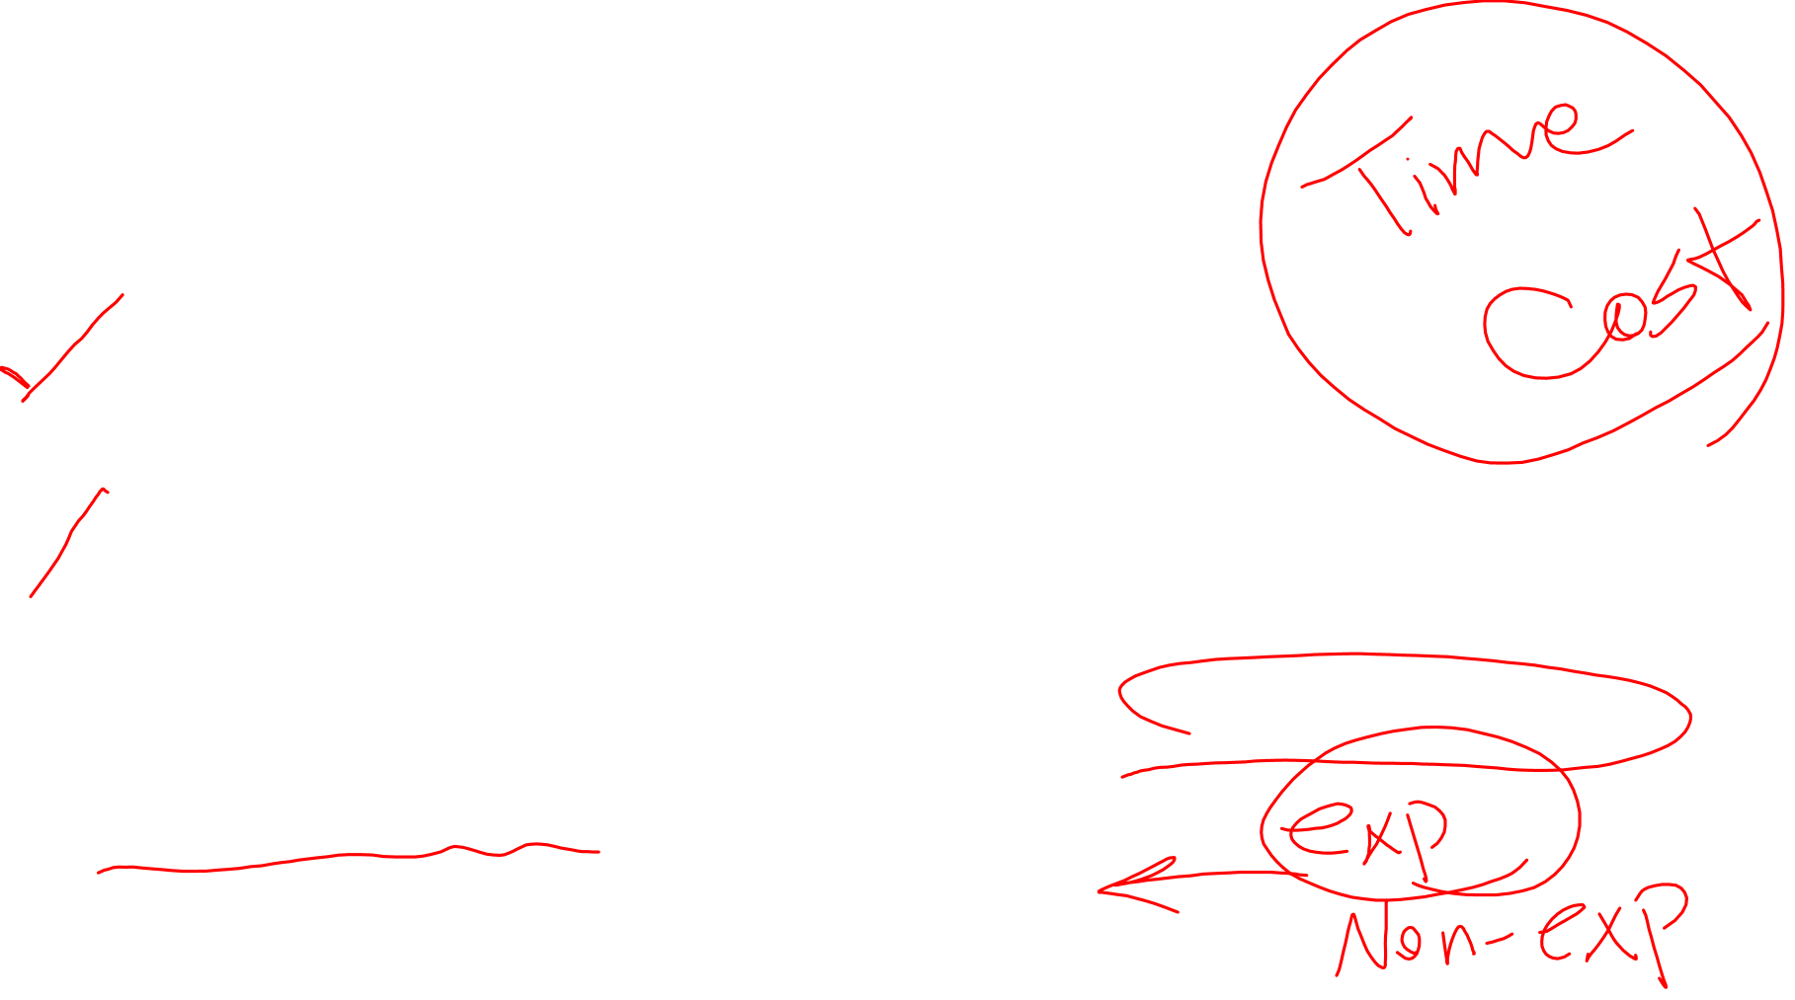
Weaknesses of Cohort Studies:
Time-consuming and expensive: Prospective studies can take many years to complete.
Loss to follow-up: Participants may drop out of the study, which can bias the results if those who drop out differ systematically from those who remain.
Difficult to study rare exposures: It may be difficult to recruit a large enough cohort with the specific exposure of interest.
Confounding variables: It can be difficult to control for all potential confounding variables that might affect the outcome.

Slide 8
Example of Cohort study: The Framingham Heart Study
Objective: To identify risk factors for cardiovascular disease.
Cohort: A group of residents from Framingham, Massachusetts, initially enrolled in 1948.
Method: Researchers followed this group over decades, collecting data on lifestyle, medical history, and other factors.
Exposure: Factors such as smoking, high blood pressure, high cholesterol, and physical activity.
Outcome: Incidence of cardiovascular diseases like heart attacks and strokes.
Findings: The study identified key risk factors associated with increased risk of heart disease, such as smoking, hypertension, and high cholesterol.

Slide 9
Example2:The Nurses' Health Study
Purpose: To investigate risk factors for chronic diseases in women.
Cohort: Over 120,000 registered nurses in the United States, enrolled starting in 1976.
Data Collected: Lifestyle factors, diet, reproductive history, medication use.
Outcome: Incidence of breast cancer, heart disease, diabetes, and other conditions.
Significance: Provided insights into how diet, exercise, and other behaviors influence women's health.

Slide 10
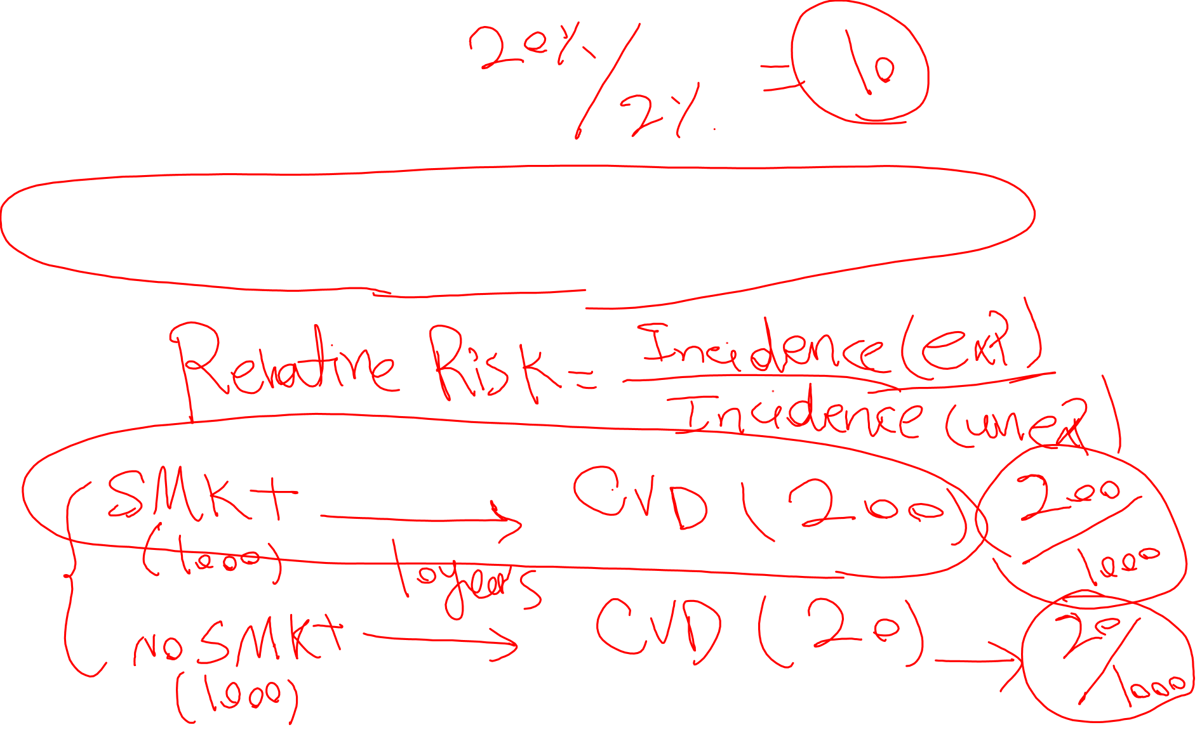
Homework
Find and check a paper that was conducted with Cohort design.

