Slide 1
Research Methods Course
Dr. Moslem Taheri Soodejani
Assistant Professor in Epidemiology
Email address: Moslem.taheri2009@yahoo.com
Healthcare Data Modeling, Departments of Biostatistics and Epidemiology, School of Public Health, Shahid Sadoughi University of Medical Sciences, Yazd, Iran
July, 2025

Slide 2

Table of contents
Title (research question)
Background
Literature review
Objectives
Study design (Epidemiological approach)
Sampling
Sample size
Data collection
Variables
Statistical analysis

Slide 3

Clinical Trials
Clinical trials are scientific studies conducted with human volunteers to evaluate the safety, effectiveness, and potential side effects of new medical interventions, such as drugs, devices, vaccines, or treatment protocols. They are essential for advancing medical knowledge and bringing new treatments to patients.

Slide 4
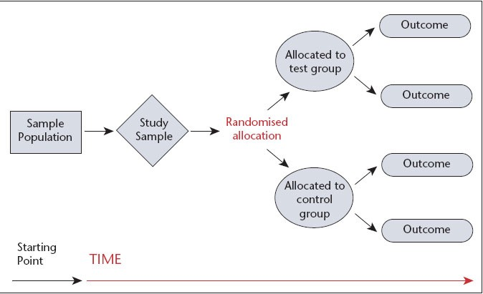

Clinical trial design

Slide 5
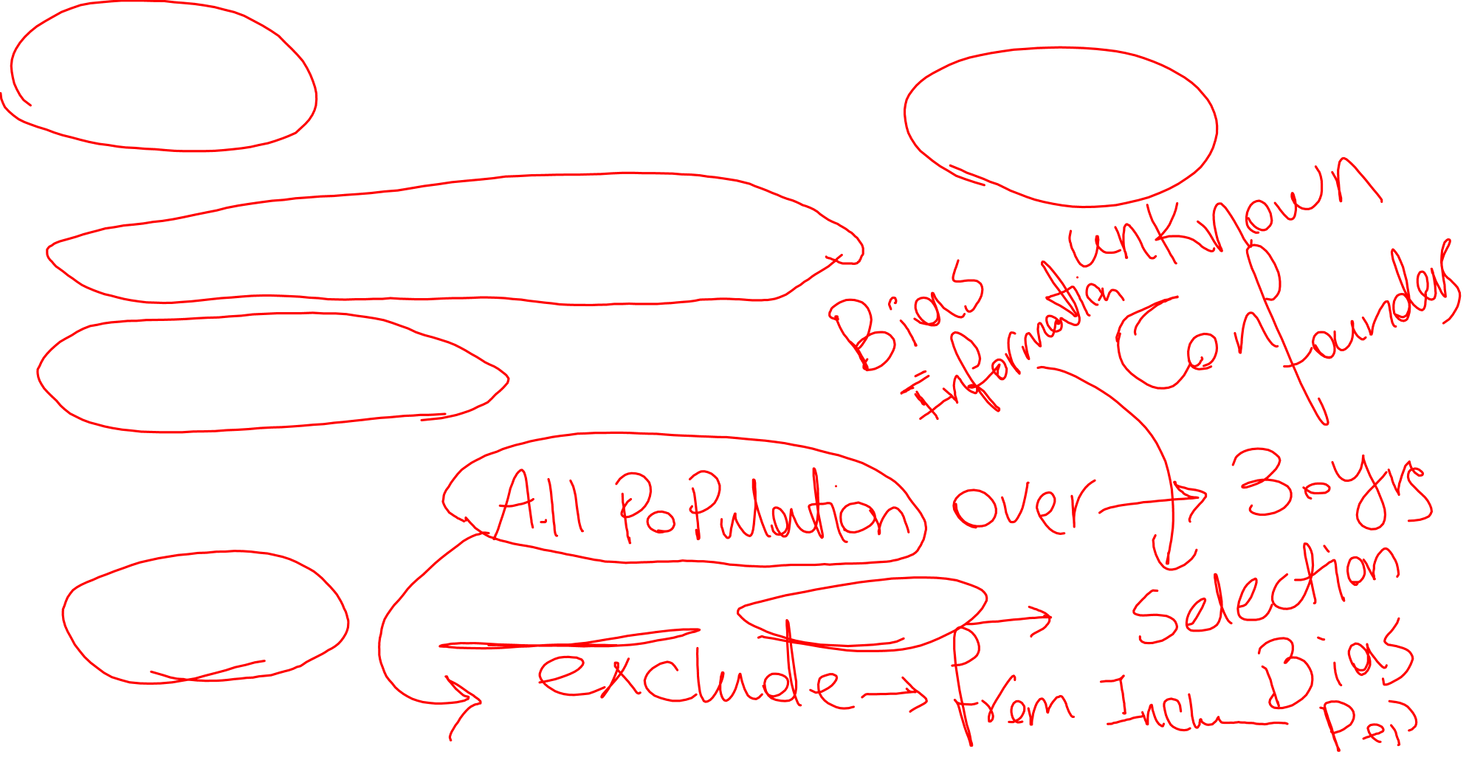
Key Elements of Clinical Trial Design
Randomization
Participants are randomly assigned to different groups to minimize bias and confounding factors.
Blinding
Single-blind: Participants are unaware of their group assignment.
Double-blind: Both participants and researchers are unaware.
Open-label: Both parties know the treatment allocation.
Inclusion and Exclusion Criteria
Defining who can or cannot participate based on factors like age, disease status, comorbidities.
Endpoints
Primary Endpoint: The main outcome used to judge effectiveness (e.g., survival rate).
Secondary Endpoints: Additional outcomes of interest (e.g., quality of life).

Slide 6
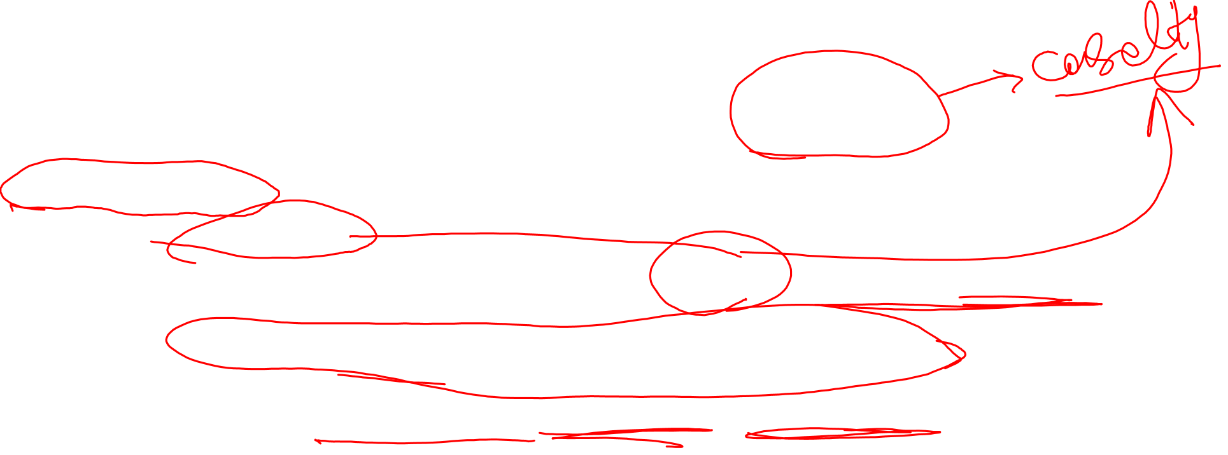
Strengths of Clinical Trial Study Design
Rigorous Evaluation: Well-designed trials provide high-quality evidence on the safety and efficacy of interventions.
Randomization: Minimizes selection bias and confounding factors, leading to more reliable results.
Control Groups: Enable comparison against placebo or standard treatment, establishing the true effect of the intervention.
Blinding: Reduces bias in outcome assessment and reporting.
Standardization: Protocols ensure consistency in data collection and management.
Regulatory Acceptance: Data from well-designed trials are often required for regulatory approval.

Slide 7

Limitations of Clinical Trial Study Design
Cost and Time: Conducting rigorous trials can be expensive and time-consuming.
Ethical Constraints: Some interventions cannot be randomized or blinded due to ethical reasons.
Limited Generalizability: Strict inclusion/exclusion criteria may limit applicability to the broader population.
Participant Dropout: Attrition can affect the power and validity of the results.
Complexity: Designing and managing trials require specialized expertise and resources.
Potential Biases: Despite efforts, biases such as selection bias or reporting bias can still occur.

Slide 8
Example
Drug Efficacy Trial
  Purpose: To evaluate whether a new medication effectively reduces symptoms of a disease.
  Example: A Phase III trial testing a new antihypertensive drug against a placebo in patients with high blood pressure.
Vaccine Trial
  Purpose: To assess the safety and effectiveness of a new vaccine.
  Example: A Phase III trial testing a COVID-19 vaccine in different age groups to determine its efficacy and side effects.

Slide 9
Example (cont.)
Diagnostic Test Study
  Purpose: To determine if a new diagnostic test accurately detects a disease.
  Example: Evaluating the sensitivity and specificity of a new blood test for early cancer detection.
Behavioral Intervention Trial
  Purpose: To assess the impact of lifestyle changes or behavioral therapies.
  Example: A trial examining the effect of a dietary intervention on glucose control in diabetic patients.
Device or Surgical Procedure Trial
  Purpose: To test the safety and effectiveness of a medical device or surgical technique.
  Example: A trial comparing a new minimally invasive surgical device to traditional surgery for knee repair.

Slide 10
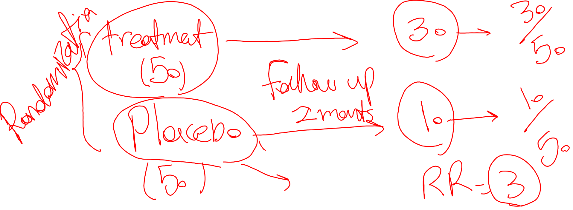
Homework
Find and check a paper that was conducted with Clinical trials design.

