Slide 1




Slide 2
Advance Research Methodology
by
MOHAMMAD ALI MOROWATISHARIFABAD
Professor
SCHOOL OF PUBLIC HEALTH
Email: morowatisharif@yahoo.com
morowaty@gmail.com
m.morowati@ssu.ac.ir

Slide 3
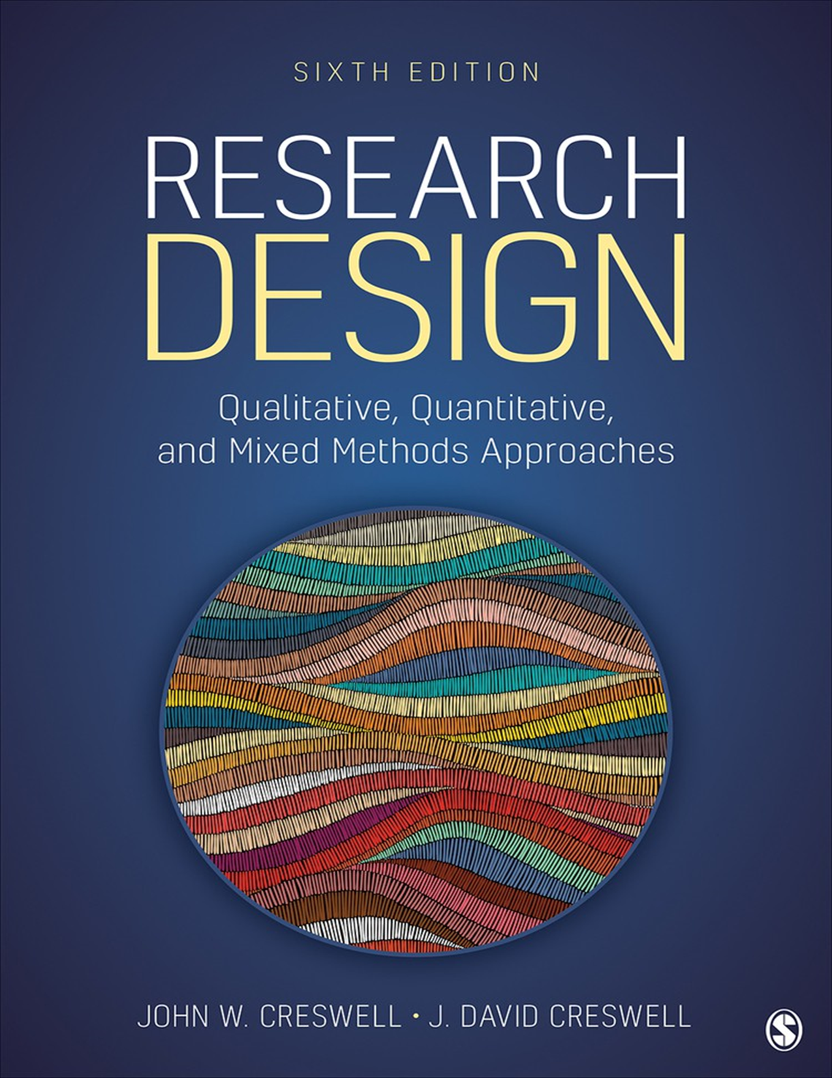
Main Refrence
John W. Creswell, J. David Creswell - Research Design_ Qualitative, Quantitative, and Mixed Methods Approaches-SAGE Publications (2023)

Slide 4
Some Other Useful References
Paula Brough - Advanced Research Methods for Applied Psychology_ Design, Analysis and Reporting-Routledge (2024)
Polit, D., & Beck, C - Essentials of nursing research_ Appraising evidence for nursing practice (2022)
Celentano, David D., Moyses Szklo, and Youssef Farag. Gordis Epidemiology E-Book: Gordis Epidemiology E-Book. Elsevier Health Sciences, 2023
Heting Chu - Research Methods and Design Beyond a Single Discipline_ From Principles to Practice-Routledge (2024)

Slide 5
CHAPTER 1 : THE SELECTION OF A RESEARCH APPROACH
Learning Objectives
Define major research terms.
Describe three major methodologies and their differences.
Explain the relationship among philosophical worldviews, designs, and methods.
Identify fitting philosophical worldviews.
Recognize types of research designs.
Differentiate quantitative, qualitative, and mixed methods.
Identify reasons for choosing a specific approach.

Slide 6
Key Terms
Research has its own language.
Philosophical Assumptions | Before a study begins, a researcher brings a point of view and a set of beliefs to the research process that informs their approach to conducting the study. Philosophical assumptions are these beliefs and values. They emphasize what the researcher holds to be most important in conducting a study. Philosophical assumptions develop from an individual’s training in a specific discipline or field of study (e.g., psychology). They also emerge from prior experiences in research and the cultural environment of an individual.
Research Approach | We will use the term research approach synonymously with research methodology. This term represents different types of research to have historically emerged. In this chapter, we will present three broad methodologies: quantitative, qualitative, and mixed methods.
Research Design | We use the term research design to mean the ways of conducting research within a broad methodology. Thus, as seen in this chapter, broad methodologies can be subdivided into different types of designs. Each design has its own procedures used in conducting a study.
Research Methods | Within a particular design, the researcher gathers data, analyzes it, and makes an interpretation of its meaning. These are the methods in a study.

Slide 7
Four Widely Discussed Philosophical Worldviews
Postpositivism
Constructivism
Transformative
Pragmatism

Slide 8
The Postpositivist Worldview
Traditional form of research: More for quantitative research.
Also known as scientific method, empirical science.
Key Idea: Challenges absolute truth of knowledge, recognizing uncertainty in studying human behavior.
Philosophy: Deterministic (causes determine effects).
Approach: Reductionistic (reducing ideas to testable sets), objective observation and measurement.
Theory: Laws/theories govern the world and need to be tested, verified, and refined.

Slide 9
Postpositivist Assumptions
Knowledge is conjectural; absolute truth is never found.
Evidence is imperfect and fallible; hypotheses are not proven, but failure to reject is indicated.
Research makes claims, then refines or abandons them.
Data, evidence, and rational considerations shape knowledge.
Seeks to develop true statements explaining situations or causal relationships.
Objectivity is essential; methods and conclusions examined for bias (e.g., validity and reliability in quantitative research).

Slide 10
The Constructivist Worldview
Philosophical Position: Used in qualitative research, often combined with interpretivism.
Core Belief: Individuals seek understanding of their world by developing subjective meanings of experiences.
Meanings: Varied and multiple; researcher seeks complexity of views.
Goal: Rely on participants' views.
Questioning: Broad and general, open-ended, allowing participants to construct meaning.
Nature of Meanings: Socially and historically negotiated through interaction and cultural norms.
Researcher Role: Background shapes interpretations; researcher positions themselves to acknowledge this.
Theory: Inquirers generate or inductively develop theory/patterns of meaning (vs. starting with theory).

Slide 11
Constructivist Assumptions
Humans construct meanings through engagement with the world they interpret.
Meaning-making is based on historical and social perspectives (culture).
Qualitative researchers seek to understand context by visiting and gathering information personally.
Researcher's own experiences and background shape interpretations.
Meaning generation is social, arising from human community interaction.
Qualitative research is largely inductive; meaning is generated from collected data.

Slide 12
The Transformative Worldview
Origin: Arose from individuals feeling postpositivist assumptions didn't fit marginalized groups or issues of power, social justice, discrimination, and oppression.
Inclusions: Critical theorists, participatory action researchers, feminists, racial/ethnic minorities, persons with disabilities, indigenous peoples, LGBTQ+ communities.
Core Belief: Research inquiry must intertwine with politics and a political change agenda to confront social oppression.
Action Agenda: Research contains an agenda for reform to change lives of participants, institutions, and the researcher.
Focus: Specific social issues (empowerment, inequality, oppression, domination, suppression, alienation).
Collaboration: Inquirer proceeds collaboratively to avoid further marginalizing participants.
Voice: Provides a voice for participants, raising consciousness or advancing change.

Slide 13
Transformative Assumptions (Mertens, 2010)
Central importance on studying lives and experiences of diverse, marginalized groups.
Focus on inequities based on gender, race, ethnicity, disability, sexual orientation, and socioeconomic class, resulting in asymmetric power relationships.
Links political and social action to these inequities.
Uses a program theory about how a program works and why problems of oppression, domination, and power relationships exist.

Slide 14
The Pragmatic Worldview
Origin: Derived from Peirce, James, Mead, Dewey; focuses on actions, situations, and consequences rather than antecedent conditions.
Concern: Applications, what works, and solutions to problems.
Emphasis: Research problem and question, using all available approaches to understand the problem.
Underpinning for Mixed Methods: Focuses attention on the research problem and uses pluralistic approaches.

Slide 15
Pragmatic Assumptions
Not committed to any one system of philosophy and reality; researchers draw liberally from quantitative and qualitative assumptions.
Freedom of choice for researchers to choose methods, techniques, and procedures that best meet their needs.
Does not see the world as an absolute unity; mixed methods researchers look to many approaches.
Truth is what works at the time; mixed methods investigators use both quantitative and qualitative data for best understanding.
Researchers look to "what and how" to research based on intended consequences.
Research always occurs in social, historical, political, and other contexts.
Opens the door to multiple methods, worldviews, assumptions, and data collection/analysis forms.

Slide 16
Four Widely Discussed Worldviews
Postpositivism | Constructivism
Determination | Understanding
Reductionism | Multiple participant meanings
Empirical observation and measurement | Social and historical construction
Theory verification | Theory generation
Transformative | Pragmatism
Political | Consequences of actions
Power and justice oriented | Problem centered
Collaborative | Pluralistic
Change oriented | Real-world practice oriented

Slide 17
Three Broad Research Approaches/ Designs
Qualitative
Quantitative
Mixed Methods
These are not rigid categories but represent a continuum.
Mixed methods research lies in the middle, incorporating elements of both.
Distinction often framed as words (qualitative) vs. numbers (quantitative).
Notes:
This slide introduces three primary research approaches: Qualitative, Quantitative, and Mixed Methods. It emphasizes that these are not strict, separate categories but rather points along a spectrum. The slide highlights that Mixed Methods research occupies the middle ground, integrating aspects of both qualitative and quantitative approaches. A key distinction often made is that qualitative research deals with "words" (non-numerical data like interviews or observations), while quantitative research focuses on "numbers" (numerical data and statistical analysis).

Slide 18
Qualitative Research Defined
Definition: An approach for exploring and understanding the meaning individuals or groups ascribe to a social or human problem.
Process: Involves emerging questions, data collected in participant's setting, inductive data analysis (from particulars to general themes), and researcher interpretations.
Report Structure: Flexible.
Emphasis: Inductive style, focus on individual meaning, reporting complexity.

Slide 19
Quantitative Research Defined
Definition: An approach for testing objective theories by examining relationships among variables or comparisons among groups.
Data: Variables are measured, typically on instruments, producing numeric data analyzed statistically.
Report Structure: Set structure (introduction, methods, results, discussion).
Emphasis: Deductive theory testing, bias protection, controlling for alternative explanations, seeking generalization and replication.

Slide 20
Mixed Methods Research Defined
Definition: Involves collecting both quantitative and qualitative data, using a specific design, combining data within the design, and drawing conclusions from combined databases.
Focus: Methods perspective focused on data collection, analysis, and interpretation.
Underpinnings: Also informed by philosophical assumptions and theories.
Rationale for combining: Neutralizes weaknesses of each data form.

Slide 21
Alternative Research Designs
Quantitative Designs | Qualitative Designs | Mixed Methods Designs
Experimental and quasi- experimental Single-subject Nonexperimental such as surveys Longitudinal | Descriptive method Narrative research Phenomenology Grounded theory | Convergent Explanatory sequential Exploratory sequential Complex designs with embedded core designs
 | Ethnography
 | Case study
Notes:
This table summarizes the specific research designs available within each of the three broad research approaches introduced previously. It categorizes various Quantitative Designs (e.g., experimental, surveys), Qualitative Designs (e.g., narrative, ethnography), and Mixed Methods Designs (e.g., convergent, explanatory sequential), providing a more detailed breakdown of the methodologies researchers can employ within each paradigm. They will be explained in detail in next slides

Slide 22
Quantitative Designs in Detail
Emerged from postpositivist worldview, originated in physiology and psychology (19th-20th centuries).
True Experiments & Quasi-experiments:
Single-subject Experiments (Applied Behavioral Analysis): Treatment administered over time to one or small number of individuals.
Nonexperimental Research:
  Causal-comparative: Compares groups based on a pre-existing cause.
  Correlational: Describes and measures association between two or more variables.
Key focus in this book: Surveys and Experiments.
Notes:
Quantitative Designs, tracing their origins to the postpositivist worldview and their development in 19th- and 20th-century physiology and psychology. It then details specific quantitative methodologies:
True Experiments & Quasi-experiments: These are research designs aimed at establishing cause-and-effect relationships, with true experiments involving random assignment and control groups, while quasi-experiments lack full random assignment.
Single-subject Experiments (Applied Behavioral Analysis): This approach focuses on administering a treatment to one or a small number of individuals over time to observe its effects.
Nonexperimental Research: This category includes designs that do not manipulate variables or randomly assign participants. Two types are highlighted:
Causal-comparative: This design compares two or more groups based on a pre-existing characteristic or "cause."
Correlational: This design measures the association or relationship between two or more variables without implying causation.

Slide 23
Key Quantitative Designs
Survey Research: Provides quantitative/numeric description of a population's trends, attitudes, or opinions by studying a sample.
  Includes cross-sectional and longitudinal studies using questionnaires or structured interviews.
Experimental Research: Seeks to determine if a specific treatment influences an outcome.
  Compares treated group to untreated group.
  Includes true experiments (random assignment) and quasi-experiments (nonrandomized assignment).
Includes single-subject designs.

Slide 24
Key Qualitative Designs
Descriptive Method: Stays close to data, uses limited frameworks, catalogues info into themes.
Narrative Research: Studies individuals' lives, asks for stories, which are often retold or restoried by researcher into a narrative chronology.
Phenomenological Research: Describes lived experiences of individuals about a phenomenon, culminating in its essence.
Grounded Theory: Derives a general, abstract theory of a process, action, or interaction grounded in participants' views, using multiple stages of data collection and refinement.
Ethnography: Studies shared patterns of behaviors, language, and actions of an intact cultural group in a natural setting over a prolonged period.
Case Studies: In-depth analysis of a case (program, event, activity, process, or individuals), bounded by time and place.
Notes:
This slide outlines key Qualitative Designs, which are research approaches focused on understanding experiences, perspectives, and meanings in depth, typically involving non-numerical data.¹ It provides a concise description of each:
Descriptive Method: This approach sticks closely to the collected data, using minimal theoretical frameworks to organize information into themes.
Narrative Research: This design involves studying individuals' lives by gathering their stories, which the researcher may then retell or restructure into a chronological narrative.²
Phenomenological Research: The aim here is to describe the shared lived experiences of individuals regarding a specific phenomenon, ultimately seeking to capture its "essence."³
Grounded Theory: This method focuses on developing a new, abstract theory about a process, action, or interaction.⁴ The theory is "grounded" in the participants' perspectives through multiple stages of data collection and refinement.⁵
Ethnography: This design involves an in-depth study of an intact cultural group in their natural setting over an extended period, focusing on their shared patterns of behaviors, language, and actions.⁶
Case Studies: This approach involves a detailed, in-depth analysis of a specific "case," which could be a program, event, activity, process, or even individuals, all within defined time and place boundaries.⁷

Slide 25
Mixed Methods Designs
A convergent mixed methods design
An explanatory sequential mixed methods design
An exploratory sequential mixed methods design
A complex mixed methods design
Notes:
This slide introduces the various Mixed Methods Designs, which are research approaches that combine both qualitative and quantitative methods within a single study. It lists four primary types:
Convergent Mixed Methods Design: In this design, qualitative and quantitative data are collected concurrently and then merged or "converged" for analysis and interpretation. The idea is to compare and contrast the findings from both types of data to gain a more comprehensive understanding of the research problem.
Explanatory Sequential Mixed Methods Design: This design involves two distinct phases. Quantitative data is collected and analyzed first, followed by qualitative data collection and analysis. The qualitative phase is used to help explain or elaborate on the initial quantitative findings.
Exploratory Sequential Mixed Methods Design: Similar to the explanatory design, this also has two phases, but the order is reversed. Qualitative data is collected and analyzed first to explore a phenomenon or generate hypotheses. This is then followed by quantitative data collection and analysis to test or generalize the initial qualitative findings.
Complex Mixed Methods Design: This refers to more intricate designs that embed core mixed methods approaches within a larger, overarching research framework. These can involve multiple phases, various data sources, and often address complex research questions that require a multifaceted approach.

Slide 26
Research Methods
Third major element in the philosophy-design-methods framework.
Involves specific forms of data collection, analysis, and interpretation.
Consider range of possibilities: predetermined nature, closed-ended vs. open-ended questioning, numeric vs. nonnumeric data analysis.
Examples: Collecting data on instruments/tests (e.g., questionnaires, checklists) or through observations without predetermined questions/open interviews.
Notes:
This slide introduces "Research Methods" as the third crucial component in the broader "philosophy-design-methods" framework for conducting research. It defines research methods as the specific techniques used for data collection, analysis, and interpretation. The slide emphasizes the variety of choices researchers have, such as using predetermined approaches versus more flexible ones, and collecting numerical versus non-numerical data. Finally, it provides examples of diverse data collection methods, ranging from structured instruments like questionnaires to more open-ended approaches like observations without predetermined questions or open interviews.

Slide 27
Quantitative, Mixed, and Qualitative Methods
Quantitative Methods | Mixed Methods | Qualitative Methods
Predetermined | Both predetermined and emerging methods | Emerging methods
Instrument-based questions | Both open- and closed- ended questions | Open-ended questions
Performance data, attitude data, observational data, and census data | Multiple forms of data drawing on all possibilities | Interview data, observation data, document data, and audiovisual data
Statistical analysis | Statistical and text analysis | Text and image analysis
Statistical interpretation | Across databases interpretation | Themes, patterns, and interpretation

Slide 28
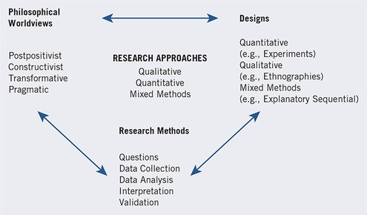
A Framework for Research—The Interconnection of Worldviews, Design, and Research Methods

Slide 29
Criteria for Selecting a Research Approach
Consider researcher's experiences, training, time, and resources.
Quantitative: Traditional, highly structured procedures, established rules.
Qualitative: Allows innovation, researcher-designed frameworks, creative writing style.
  Typically best for social justice or community involvement studies.
Mixed Methods: Requires extra time due to collecting and analyzing both data types.
Notes:
This slide outlines the Criteria for Selecting a Research Approach, emphasizing that the choice between qualitative, quantitative, or mixed methods designs is influenced by several practical considerations.
It highlights the researcher's individual experiences, training, available time, and resources as crucial factors.
Quantitative approaches are presented as traditional, highly structured, and governed by established rules, suggesting they might be favored by researchers with a strong background in statistical analysis and structured methodologies.
Qualitative approaches, in contrast, are characterized by their flexibility, allowing for innovation, researcher-designed frameworks, and a creative writing style. They are noted as particularly suitable for studies involving social justice or community involvement, implying their strength in exploring nuanced human experiences and societal issues.
Mixed Methods approaches are identified as requiring additional time due to the need to collect and analyze both quantitative and qualitative data, suggesting they are a more resource-intensive option.

Slide 30
This is an educational content from the first chapter of the reference book, which was prepared primarily to receive your feedback on its suitability. Please provide me with your feedback via email or WhatsApp so that it can be used in preparing subsequent chapters.
Please email me if you do not have the reference book so that I can send it to you.
morowatisharif@yahoo.com
+989133530374

