Slide 1

بسم الله الرحمن الرحیم

Slide 2
Chapter 4: Writing Strategies and Ethical Considerations
Learning Objectives of Chapter
Identify the nine key topics to include in a proposal or a research study.
Compare the differences in the structure of proposals for quantitative, qualitative, and mixed methods research studies.
Evaluate the quality of your writing for conciseness, coherence, and unnecessary words.
Identify ethical issues and strategies for addressing them before, during, and after a study.

Slide 3
Introduction to Proposal Design
Before designing a proposal, plan its general structure or outline.
The structure of a proposal differs based on the research approach: quantitative, qualitative, or mixed methods.
Good writing practices are essential for a consistent and easily readable proposal.
Anticipating and addressing ethical issues is crucial throughout all phases of the study.

Slide 4
Nine Key Topics in a Research Proposal (Maxwell, 2013)
What do readers need to better understand your topic?
What do readers know about your topic?
What do you propose to study?
What is the setting, and who are the people you will study?
What methods do you plan to use to collect data?
How will you analyze the data?
How will you validate your findings?
What ethical issues will your study present?
What do preliminary results show about the feasibility and value of the proposed study?

Slide 5
Importance of Maxwell's Nine Questions
These nine questions form the foundation and overall structure for a good research proposal.
Elements often overlooked, but crucial, include validation, ethical considerations, preliminary results, and early evidence of practical significance.

Slide 6
Qualitative Proposal: Constructivist/Interpretivist Format Overview
Example 4.1 A Qualitative Constructivist or Interpretivist Format
Introduction
Statement of the Problem (including existing literature, deficiencies in the literature, and relevance of study for audiences)
Purpose of the Study The Research Questions
Philosophical Assumptions or Worldview and Theory Procedures
Qualitative Design (e.g., descriptive, ethnography, case study) Role of the Researcher
Data Collection Procedures Data Analysis Procedures
Proposed Narrative Structure for Findings Strategies for Validation
Anticipated Ethical Issues Preliminary Pilot Findings (if available)
Expected Impact and Significance of Study References
Appendixes: Interview Questions and Protocol, Observational Forms, Timeline for the Study, Proposed Budget, Summary of the Proposed Content of Each Chapter in the Final Study

Slide 7
Qualitative Proposal: Participatory/Social Justice Format
Similar to the constructivist/interpretivist format, but identifies a specific participatory or social justice framework (e.g., oppression, discrimination, community involvement).
Includes collaborative data collection approaches.
Mentions the anticipated transformative changes resulting from the research study.

Slide 8
Quantitative Proposal Format Overview
Conforms to sections typically found in quantitative journal articles.
Generally follows the model of Introduction and Literature Review, Method, Results, and Discussion.
Example 4.3 A Quantitative Format
Introduction and Literature Review
Statement of the Problem (issue, theory, existing literature about problem, deficiencies in literature, relevance of study for audiences)
Purpose of the Study
Research Questions or Hypotheses Method
Population, Sample, Participants, Recruitment of Participants Type of Research Design (e.g., experimental, survey)
Procedure (procedures and variables, instruments and materials, ethical considerations) Data Analysis Procedures
Preliminary Studies or Pilot Tests
Appendixes: Instruments and Materials, Timeline, Proposed Budget, Outline of Proposed Chapters

Slide 9
Mixed Methods Proposal Format Overview
Brings together quantitative and qualitative research.
Introduction: The Research Problem (deficiencies in past research, need for both data types, insight from combining/integrating).
Purpose or Study Aim: Overall intent of collecting and combining quantitative and qualitative data.
Research Questions and Hypotheses: Quantitative questions/hypotheses, qualitative questions, mixed methods integration questions.
Philosophical Assumptions or Worldview and Theory.
Literature Review: Typically reviews quantitative, qualitative, and mixed methods studies, indicating the need for a mixed methods study.
Methods: Definition of Mixed Methods Research & Rationale, Type of Mixed Methods Design, Diagram of the Design, Validity Challenges.
(Data & Integration)
Quantitative Data Collection and Analysis (ordered to fit the mixed methods design).
Qualitative Data Collection and Analysis.
An Integration Statement.
A Sample Joint Display Template.
Anticipated Insights or Metainferences.
Researcher's Resources and Skills to Conduct Mixed Methods Research.
Potential Ethical Issues.
References & Appendixes.

Slide 10
Tips for Designing Proposal Sections
Specify sections early in the design; work on one section often prompts ideas for others.
Develop an outline first, then write rapidly for each section to get ideas down, followed by refinement.
Find and study proposals authored by other students under your adviser.
Examine topics, their order, and the level of detail in successful proposals.
Determine if your program or institution offers a course on proposal development.
Sit with your adviser to go over their preferred format and obtain guiding examples.
Consider the appropriate length of the proposal; often not exceeding 30 pages, but varies by adviser and institution.
Some expect the first three chapters of the dissertation (introduction, literature review, and methods) as a proposal.

Slide 11
Shahid Sadoughi University of Medical Sciences
Department for Research
Title:
Investigator(s):
Date:
Research Project Proposal
Project Title:
Investigators and Cooperators
  Principal Investigators:
Name, Affiliation
Address:
Postal code: 89179-45556, Yazd, Iran Tel: (+98-351) 725 84 10 Fax: (+98-351) 725 84 13 Mobile: (+98) E-mail:
Research Project:
  Statement of the Problem: Literature Review: General Objective(s): Specific Objective(s):
Methodology Procedures: Study Design: Variables: Study Type: Sampling: Data Collection and Analysis:
  Ethics: Research Timetable for Project
Budget Personnel Budget: Services: Materials and Instruments: Trips: - Other Costs: - Total Budget Request:
References list

Slide 12
Writing Strategies: The Process
Write ideas down early rather than just talking about them; writing helps organize thoughts and visualize the final product.
Before designing a full proposal, draft a one- to two-page overview for adviser approval.
This overview should include the research problem, purpose, central questions, data sources, significance, and practical considerations.
Drafting Iterations
Work through several drafts of a proposal rather than trying to polish the first draft.
Elbow (1973) recommends an iterative process: for a 1-hour passage, write four 15-minute drafts instead of one in the last 15 minutes.
Experienced researchers write the first draft carefully but polish comes relatively late.

Slide 13
Franklin's Three-Stage Model for Writing
Develop an outline: This can be a sentence or word outline, or a visual map.
Write out a draft: Shift and sort ideas, moving entire paragraphs around the manuscript.
Edit and polish: Focus on refining each individual sentence.

Slide 14
The Habit of Writing
Establish the discipline or habit of writing regularly and continuously.
Write some sections, then set them aside to gain perspective upon return.
Avoid being a "weekend writer"; continuous work means daily engagement in thinking, collecting information, and reviewing.
Select a suitable time and place free of distractions for daily writing.

Slide 15
Boice's Ideas for Good Writing Habits
Set a priority on writing and make it a daily activity, regardless of mood.
Write when you are fresh.
Avoid writing in binges; write in small, regular amounts.
Schedule writing tasks into specific, manageable units for each session.
Keep daily charts tracking time spent, page equivalents finished, and percentage of planned task completed.
Plan beyond daily goals and share writing with supportive friends before going public.

Slide 16
Clear and Concise Writing: Readability
Enhance readability by presenting ideas in an orderly manner and using transitional words.
Use consistent terms throughout the proposal (e.g., consistent name for variables or central phenomena).
Refrain from using synonyms for key terms to avoid misunderstanding and subtle shifts in meaning.

Slide 17
Narrative Thoughts (Tarshis, 1982)
Writers should consider the purpose of different-sized narrative thoughts:
  Umbrella thoughts: General or core ideas.
  Big thoughts: Specific ideas reinforcing umbrella thoughts.
  Little thoughts: Ideas reinforcing big thoughts.
  Attention or interest thoughts: Keep the reader on track, organize ideas, and maintain attention.
Beginning researchers often struggle with umbrella and attention thoughts.

Slide 18
Addressing Narrative Thought Problems
A proposal may have too many umbrella ideas without sufficient detailed content to support them (e.g., in literature reviews with too many small, unconnected sections).
Attention thoughts (organizational statements) are needed as "road signs" to guide the reader between major ideas.
Organizing paragraphs are useful at the beginning and end of sections like literature reviews

Slide 19
Coherence in Writing
Coherence means ideas tie together and logically flow from sentence to sentence and paragraph to paragraph.
Repetition of variable names in the title, purpose statement, research questions, and literature review headings adds coherence in quantitative projects.
Consistent order of independent and dependent variables also contributes to coherence

Slide 20
Hook-and-Eye Exercise (Wilkinson, 1991)
A useful technique for connecting thoughts from sentence to sentence and paragraph to paragraph.
Examine writing, circle key ideas ("eyes") in each sentence, and connect sentences (or paragraphs) with a line ("hook").
Good connections indicate coherence; difficult connections show a lack of it, requiring transitional words or phrases.
This technique applies to connecting chapters as well as sentences and paragraphs.

Slide 21
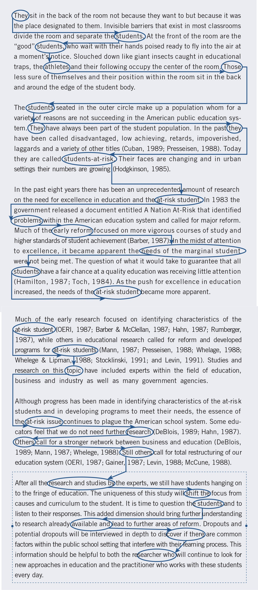
An Illustration of the Hook and Eye Technique

Slide 22
Voice, Tense, and "Fat" (Conciseness)
These aspects address the "polish" level of writing.
Eliminate "fat": Wolcott (2009) recommends eliminating unnecessary words, deleting the passive voice, scaling down qualifiers, eliminating overused phrases, and reducing excessive quotations, italics, and parenthetical comments.
Active voice: Use as much as possible; the subject acts on the verb.
  Passive construction uses auxiliary verbs (e.g., was, will be, have been) and can be used when the actor can be omitted.
Strong verbs: Use active verbs, avoiding "lazy" verbs like "is" or "was."

Slide 23
Verb Tense in Scholarly Writing
Past tense: Commonly used to review literature and report results of past studies, especially in quantitative research.
Future tense: Appropriately indicates that the study will be conducted in the future, key for proposals.
Present tense: Adds clarity, especially in the introduction, and frequently occurs in qualitative studies

Slide 24
Thank you for your attention

