Slide 1

بسم الله الرحمن الرحیم

Slide 2
Chapter 6: The Purpose Statement
Defining the Intent of Your Research Study
Learning Objectives of Chapter 6
Describe the relationship among the problem, the purpose statement, and the research questions.
In writing a purpose statement (or study aim) for a qualitative study, identify the three major components.
Identify the central phenomenon in a qualitative purpose statement.
State a quantitative purpose statement with variables and their relationships.
Describe the four essential components of a mixed methods purpose statement.

Slide 3
Shahid Sadoughi University of Medical Sciences
Department for Research
Title:
Investigator(s):
Date:
Research Project Proposal
Project Title:
Investigators and Cooperators
  Principal Investigators:
Name, Affiliation
Address:
Postal code: 89179-45556, Yazd, Iran Tel: (+98-351) 725 84 10 Fax: (+98-351) 725 84 13 Mobile: (+98) E-mail:
Research Project:
  Statement of the Problem: Literature Review: General Objective(s): Specific Objective(s):
Methodology Procedures: Study Design: Variables: Study Type: Sampling: Data Collection and Analysis:
  Ethics: Research Timetable for Project
Budget Personnel Budget: Services: Materials and Instruments: Trips: - Other Costs: - Total Budget Request:
References list

Slide 4
Introduction to the Purpose Statement
It is important to clearly state a purpose statement in the abstract and introduction of a research study.
This statement establishes the intent or objective of the research study.
It is a critical statement that needs to be clear, specific, and informative.
Other aspects of the research follow from it, and readers may be lost if it is unclear.
In journal articles, purpose statements are often embedded in introductions (and abstracts); in theses and dissertations, it often stands as a separate section.

Slide 5
Significance of a Purpose (or Study Aim) Statement
In social science research, "purpose" is typically used. In health sciences, "study aim" is often preferred.
This statement sets the stage for the entire study.
It indicates the primary goal or overarching objective of the research.
A well-crafted purpose statement provides focus and direction for the research design, data collection, and analysis.

Slide 6
Key Principles in Designing a Purpose Statement
A purpose statement should be a single sentence or a few sentences.
It should be informative, specific, and clear.
Use words that signal the overall intent of the study.
It should follow the problem statement in a proposal or study.
It should narrow the problem statement to what the study will accomplish.

Slide 7
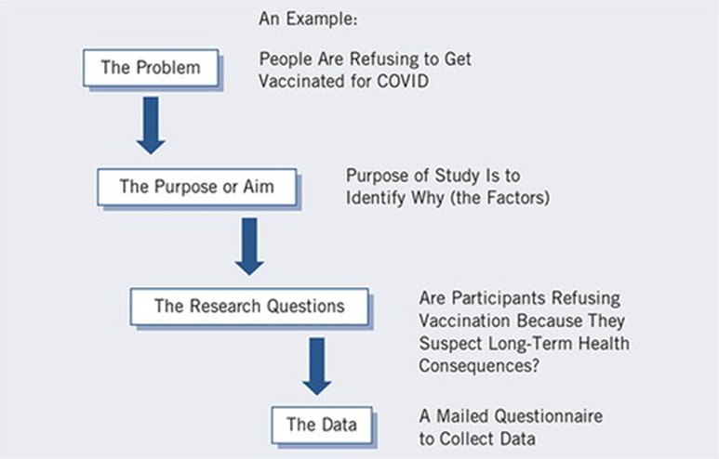
Relationship among Problem, Purpose, and Questions

Slide 8
Relationship among Problem, Purpose, and Questions
The Problem: The larger issue or concern that drives the need for the study (e.g., people refusing COVID vaccination).
The Purpose or Aim: The overall intent or objective of the study (e.g., to identify why, the factors).
The Research Questions: Specific questions the study will answer to achieve its purpose (e.g., Are participants refusing vaccination because they suspect long-term health consequences?).
The Data: The specific information collected to answer the questions (e.g., a mailed questionnaire).

Slide 9
Qualitative Purpose Statements: Definition and Components
A qualitative purpose statement indicates the intent to explore or understand a central phenomenon.
It conveys an emerging design and research process.
It does not convey a directional or cause-and-effect relationship between variables.
Three major components:
  Use action verbs that convey the discovery process (e.g., "explore," "understand," "discover," "describe," "generate").
  Use neutral, non-directional language (avoid words like "effect," "influence," "impact," "determine").
  Provide a general, tentative definition of the central phenomenon.

Slide 10
Qualitative Purpose Statements: Location and Language
Typically found in the introduction section of a qualitative study.
Use phrases that signal the intent (e.g., "The purpose of this study is...").
Identify the participants in the study and the research site.
Define the central phenomenon.

Slide 11
Example of a Qualitative Purpose Statement Script
"The purpose of this [research design] study will be to [action verb, e.g., "explore," "understand," "discover"] the [central phenomenon] for [participants] at [research site]."
Example: "The purpose of this ethnographic study will be to understand the lived experiences of recent immigrant families adjusting to life in a new urban community."

Slide 12
Quantitative Purpose Statements: Definition and Components
A quantitative purpose statement identifies the variables and their relationship or comparison.
It focuses on testing a theory or an explanation.
It typically includes words that indicate testing relationships or comparing groups.
Four key components:
  Identify the major variables in the study (independent, dependent, mediating, moderating).
  Mention the theory, model, or conceptual framework being tested (e.g., "test the theory of...," "relate...to...").
  Identify the participants (sample) in the study.
  Identify the research site.

Slide 13
Quantitative Purpose Statements: Language and Structure
Use words like "relate," "compare," "test the effect of," "examine the relationship between," or "compare...with...".
The variables are often clearly defined and may be listed in order (independent, dependent).
The statement is typically precise and measurable.

Slide 14
Example of a Quantitative Purpose Statement Script (Relational)
"The purpose of this [research design] study is to [action verb, e.g., "relate," "compare"] the [independent variable] to [dependent variable] for [participants] at [research site]."
Example: "The purpose of this correlational study is to examine the relationship between perceived stress (independent variable) and academic performance (dependent variable) among undergraduate students (participants) at a large public university (research site)."

Slide 15
Example of a Quantitative Purpose Statement Script (Comparison)
"The purpose of this [research design] study is to [action verb, e.g., "compare"] the [dependent variable] of [participants] based on their [independent variable] at [research site]."
Example: "The purpose of this experimental study is to compare the academic achievement (dependent variable) of high school students (participants) who receive traditional instruction with those who receive technology-enhanced instruction (independent variable) in three urban high schools (research site)."

Slide 16
Mixed Methods Purpose Statements: Rationale for Combination
Emphasize the benefit of having both numerical (quantitative) and textual/visual (qualitative) data.
Explain how one type of data will enhance, explain, or complement the other.
Use phrases that signal integration, such as "to gain a more complete understanding," "to explore in more depth," or "to confirm findings."

Slide 17
Example of a Mixed Methods Purpose Statement Script (Explanatory Sequential)
"The purpose of this explanatory sequential mixed methods study is to first quantitatively examine [quantitative variables/relationships] for [participants] at [research site], and then qualitatively explore [qualitative phenomenon] through [qualitative participants] to explain the quantitative results."
Example: "The purpose of this explanatory sequential mixed methods study is to first quantitatively examine the relationship between faculty mentorship and student retention rates for undergraduate engineering students at a Midwestern university, and then qualitatively explore the experiences of retained and non-retained students to explain the quantitative results."

Slide 18
Considerations for Writing Purpose Statements
Be concise: The purpose statement should typically be a single sentence or a very short paragraph.
Be precise: Use clear, unambiguous language.
Be consistent: Ensure the purpose statement aligns with your research problem, questions, and chosen methodology.
Avoid jargon: Write for a broad audience unless specifically instructed otherwise.

Slide 19
Common Mistakes in Purpose Statements
Being too broad or vague.
Not clearly indicating the research approach (qualitative, quantitative, mixed methods).
Including too much detail that belongs in the methods section.
Stating personal goals rather than research objectives.
Not aligning with the research questions that follow.

Slide 20
Purpose Statement as a Foundation
The purpose statement acts as the foundation upon which your entire research design is built.
It guides the development of your research questions or hypotheses.
It dictates the type of data you will collect and how you will analyze it.

Slide 21
Iterative Process of Writing
Writing a purpose statement is often an iterative process.
You may draft it early, but refine it as your understanding of the research problem, literature, and methods deepens.
Seek feedback from mentors, peers, and committee members to ensure clarity and precision.

Slide 22
Distinguishing Purpose from Problem and Questions
The problem identifies the general issue or concern.
The purpose states the overall objective or intent of your specific study related to that problem.
The research questions are the specific queries you will answer to achieve your purpose.

Slide 23
Practical Tips for Crafting Your Statement
Brainstorm key concepts and relationships before writing.
Use the provided scripts as templates, filling in your specific details.
Read examples from high-quality studies in your field.
Get feedback to refine clarity and conciseness.

Slide 24
Importance for Readers and Reviewers
A well-written purpose statement immediately informs readers and reviewers about the study's core aim.
It demonstrates the researcher's clarity of thought and the systematic nature of the research plan.
It helps reviewers assess the alignment between the proposed study and the research questions/methods.

Slide 25
Purpose Statement in the Abstract vs. Introduction
In an abstract, the purpose statement is concise and often integrated into a single paragraph summary.
In the introduction, it might be presented as a standalone sentence or a short paragraph after the problem statement and literature review, providing a clear transition to the research questions.

Slide 26
Aligning with Research Design
The purpose statement should clearly indicate the chosen research design (e.g., "The purpose of this correlational study...", "The purpose of this ethnographic study...", "The purpose of this convergent mixed methods study...").
This helps ground the study within its methodological approach.

Slide 27
Ensuring Specificity
While a purpose statement should be broad enough to encompass the study's scope, it should also be specific enough to provide clear direction.
Avoid overly general terms that do not convey the unique contribution of your study.

Slide 28
Final Review of Purpose Statement
Before finalizing, ensure the purpose statement:
  Is clear and concise.
  Uses appropriate language for your research approach.
  Identifies key elements (phenomenon/variables, participants, site).
  Justifies the study's existence and aligns with the problem.
  Leads logically to the research questions.

Slide 29
Significance for the Entire Research Process
The purpose statement is not just a formality; it serves as a guiding star throughout the entire research process, from conceptualization to interpretation and dissemination of findings.

Slide 30
Thank you for your attention

